Slide 1
Recent Trends in Large Scale Data Intensive Systems
Barzan Mozafari
(presented by Ivo D. Dinov)
University of Michigan, Ann Arbor

Slide 2
Research Goals
Using statistics to build better data-intensive systems
Faster
  How to query petabytes of data in seconds?
More predictable
  How to predict the query performance?
  How to design a predictable database in the first place?

Slide 3


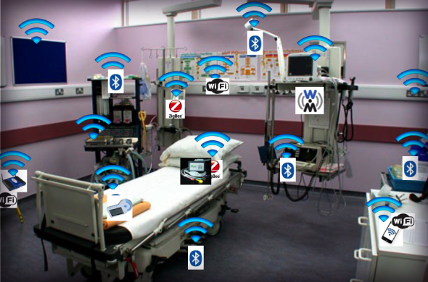


Big Data
Online Media Websites, Sensor Data
Real-time Monitoring, Data Exploration
Notes:
These days we are confronted with massive amounts of data which ultimately derives its value from being processed in a timely manner
For eg. online media websites, which experience an influx of hundreds of terabytes of data everyday, need to find quick ways to analyze this data across a number of dimensions to see, for instance how an ad is performing, identifying spam or in training better recommendation systems.

Slide 4
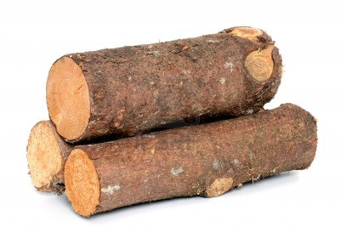
Big Data
Log Processing
Root-cause Analysis, A/B Testing
Notes:
Similarly, terabytes of event logs are being collected and need to be quickly processed everyday to look and act on anomalies or find specific patterns. [pause]
Now while I can go on and on about these usercases, the key problem...

Slide 5
Problem
Problem: Analytical queries over massive datasets are becoming extremely slow and expensive
Goal: Support interactive, ad-hoc, exploratory analytics on massive datasets
Notes:
(such as AVG, SUM, COUNT, VARIANCE, STDEV and PERCENTILES)

Slide 6
Recent Trends in Large Data Processing
Computational Model: Embarrassingly parallel
  Map-Reduce
Software: fault tolerant
Hadoop (OS for data centers)
Hardware: Commodity servers (lots of them!)
Realization: Moving towards declarative languages such as SQL

Slide 7
Trends in Interactive SQL Analytics
Impala
Presto
Stinger
Hive
Spark SQL
Redshift
HP Vertica
...
Less I/O
  Columnar formats / Compression
  Caching Working Sets
  Indexing
Less Network
  Local Computations
Faster Processing
  Precomputation
  More CPUs/GPUs
Good But Not Enough!
Because Data is Growing Faster
than Moore’s Law!
Notes:
So if you look at the successful systems over the past few years, you see that there’s a fierce competition over doing SQL analytics at interactive speeds.
But the way this is done so far is that it’s been all about who can implement more of the traditional query optimization techniques first.
Now all these optimization techniques are great and very effective, but they’re not going to be enough because these optimization techniques only give you linear speed ups while we need
exponential speed ups to keep up with the data groth because as we know data is already growing faster than Moore’s law. This means our hardware is not improving fast enough to keep up with our data,
So even if you’re only looking at the last hour of your data it will eventually get big enough that you won’t be able to process it fast enough.

Slide 8
Data Growing Exponentially, faster than our ability to process it!
Estimated Global Data Volume*:
  2011: 1.8 ZB => 2015: 7.9 ZB
  (ZB = 10²¹ = 1 million PB = 1 billion TB)
World's information doubles every two years
Over next 10 years:
  # of servers will grow by 10x
  data managed by enterprise data centers by 50x
  # of “files” enterprise data center by 75x
  Kryder’s law (storage) outpaces Moore’s law (comput. power)**
* 2011 IDC Digital Universe Study
** Dinov et al., 2014

Slide 9
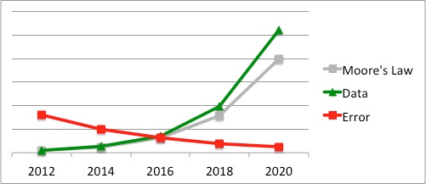
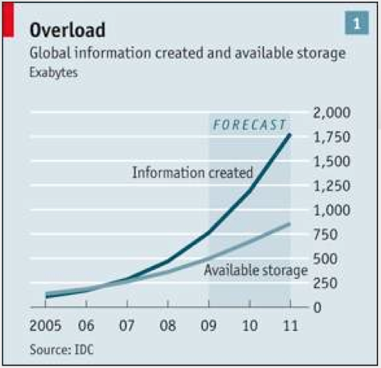
Data vs. Moore’s Law
“For Big Data, Moore’s Law Means Better Decisions”, by Ion Stoica
IDC Report

Slide 10
Outline
BlinkDB: Approximate Query Processing
Verdict: Database Learning

Slide 11
BlinkDB:
Query Petabytes of Data in a Blink Time!
Sameer Agarwal, Barzan Mozafari, Aurojit Panda, Henry Milner, Samuel Madde, Ion Stoica

Slide 12


100 TB & 1,000 cores
1-2 Hours
25-30 Minutes
1 second
?
Hard Disks
Memory
Notes:
“Intuition”
----- Meeting Notes (4/8/13 21:12) -----
exploratory stories--- can't spend 30 mins on each query!
1 seconds → means precomputed “summaries” or samples
Subsets…
Interface slide

Slide 13

Target Workload
Real-time latency is valued over perfect accuracy
“On a good day, I can run up to 6 queries in Hive.”
- Anonymous Data Scientist at
Notes:
Real-time latency is valued perfect accuracy
Adhoc: Queries are not known in advance!
Popular column sets are stable!
UDFs are common
Curse of dimensionality
Skewed data
Accuracy Guarantees are needed

Slide 14
Target Workload
Real-time latency is valued over perfect accuracy: ≤ 10 sec for interactive experience
“On a good day, I can run up to 6 queries in Hive.”
- Anonymous Data Scientist at
Notes:
Real-time latency is valued perfect accuracy
Adhoc: Queries are not known in advance!
Popular column sets are stable!
UDFs are common
Curse of dimensionality
Skewed data
Accuracy Guarantees are needed

Slide 15
Target Workload
Real-time latency is valued over perfect accuracy: ≤ 10 sec for interactive experience
Exploration is ad-hoc
Notes:
Real-time latency is valued perfect accuracy
Adhoc: Queries are not known in advance!
Popular column sets are stable!
UDFs are common
Curse of dimensionality
Skewed data
Accuracy Guarantees are needed

Slide 16
Target Workload
Real-time latency is valued over perfect accuracy: ≤ 10 sec for interactive experience
Exploration is ad-hoc
User defined functions (UDF) must be supported: 43.6% of Conviva’s queries
Data is high-dimensional & skewed: +100 columns
Notes:
Real-time latency is valued perfect accuracy
Adhoc: Queries are not known in advance!
Popular column sets are stable!
UDFs are common
Curse of dimensionality
Skewed data
Accuracy Guarantees are needed

Slide 17
100 TB & 1,000 cores
1-2 Hours
25-30 Minutes
1 second
?
Hard Disks
Memory
One can often make perfect decision without
perfect answers
Approximation using Offline Samples
Sampling-based Approximation
Approximation
Notes:
“Intuition”
----- Meeting Notes (4/8/13 21:12) -----
exploratory stories--- can't spend 30 mins on each query!
1 seconds → means pre-computed “summaries” or samples
Subsets…
Interface slide

Slide 18
BlinkDB Interface
SELECT avg(sessionTime)
FROM Table
WHERE city=‘San Francisco’
WITHIN 1 SECONDS
234.23 ± 15.32
Notes:
[verbose]
This in turn enables us to answer queries within specific time intervals or error bounds.
For eg. in the first example, a query can be augmented with a one second time bound, and BlinkDB will try to return the most accurate answer within the time bound.
Similarly, a query can be augmented with a specific error bound and a confidence interval in which the system will return the fastest possible answer within this bound.
We believe that using BlinkDB, a user will be able to rapidly compute fairly sophisticated statistics on large data

Slide 19
BlinkDB Interface
SELECT avg(sessionTime)
FROM Table
WHERE city=‘San Francisco’
WITHIN 2 SECONDS
234.23 ± 15.32
239.46 ± 4.96
SELECT avg(sessionTime)
FROM Table
WHERE city=‘San Francisco’
ERROR 0.1 CONFIDENCE 95.0%
Notes:
BlinkDB tries to solve this problem by maintaining multi-granular samples on input data.
This in turn enables us to answer queries within specific time intervals or error bounds.
For eg. in the first example, a query can be augmented with a one second time bound, and BlinkDBwill try to return the most accurate answer within the time bound.
Similarly, a query can be augmented with a specific error bound and a confidence interval in which the system will return the fastest possible answer within this bound.
We believe that using BlinkDB, a user will be able to rapidly compute fairly sophisticated statistics on large data

Slide 20
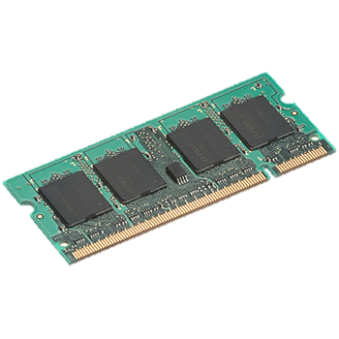
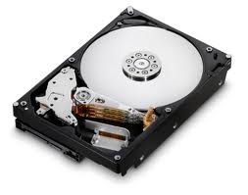
BlinkDB Architecture
Offline sampling:
  Uniform
  Stratified on different sets of columns
  Different sizes
…
…
TABLE
Sampling Module
…
…
Original
Data
…
…
On-Disk
Samples
In-Memory
Samples
Notes:
To implement this functionality, BlinkDB uses an off-line module to build a set of samples for the original tables. These includes an uniform sample

Slide 21
BlinkDB Architecture
SELECT foo (*)
FROM TABLE
IN TIME 2 SECONDS
Query Plan
Sample Selection
Predict time and error of the query for each sample type
…
…
TABLE
…
…
Sampling Module
Original
Data
…
…
On-Disk
Samples
In-Memory
Samples

Slide 22
BlinkDB Architecture
SELECT foo (*)
FROM TABLE
IN TIME 2 SECONDS
New Query Plan
Hive
Sample Selection
Hadoop
Spark
Presto
Parallel execution
…
…
TABLE
Error Bars & Confidence Intervals
…
…
Sampling Module
Original
Data
…
Result
…
182.23 ± 5.56
(95% confidence)
On-Disk
Samples
In-Memory
Samples
Notes:
Reminder: Hive is a very popular data warehouse, which is an open-source implementation of SQL that uses Hadoop

Slide 23
Main Challenges
How to accurately estimate the error?
What if the error estimate itself is wrong?
Given a storage budget, which samples to build & maintain to support a wide range of ad-hoc exploratory queries?
Given a query, what should be the optimal sample type and size that can be processed to meet its constraints?
Notes:
----- Meeting Notes (4/8/13 22:14) -----
decide on the optimal set of samples to support adhoc exploratory queries

Slide 24
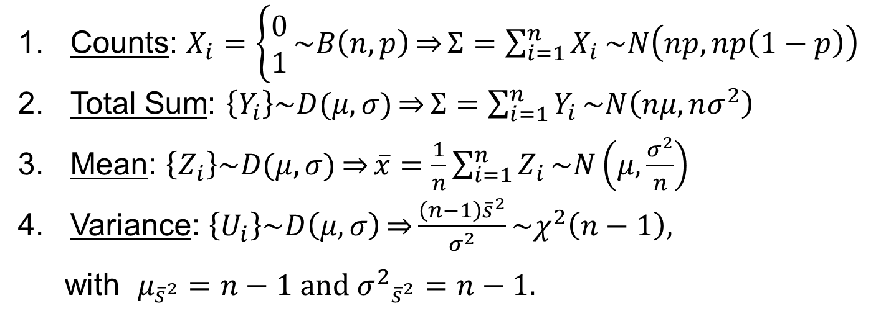
Closed-Form Error Estimates
    Central Limit Theorem (CLT)
Counts: $X_{i}=\left\{\begin{aligned}0 \\ 1\end{aligned}\right.\sim B\left(n,p\right)\overset{⇒}{}Σ=\sum_{i=1}^{n}{X_{i}}\sim N\left(np,np\left(1−p\right)\right)$
Total Sum: $\left\{Y_{i}\right\}\sim D(μ,σ)\overset{⇒}{}Σ=\sum_{i=1}^{n}{Y_{i}}\sim N\left(nμ,nσ^{2}\right)$
Mean: $\left\{Z_{i}\right\}\sim D(μ,σ)\overset{⇒}{}\overline{x}=\frac{1}{n}\sum_{i=1}^{n}{Z_{i}}\sim N\left(μ,\frac{σ^{2}}{n}\right)$
Variance: $\left\{U_{i}\right\}\sim D\left(μ,σ\right)\overset{⇒}{}\frac{\left(n−1\right){\overline{s}}^{2}}{σ^{2}}\sim χ^{2}\left(n−1\right),$
with $μ_{{\overline{s}}^{2}}=n−1 and {σ^{2}}_{{\overline{s}}^{2}}^{}=n−1.$
    What about more complex queries?
      UDFs, nested queries, joins, ...
Notes:
If you have a an iid sample of a distribution w/ finite mean and variance, the mean of that sample is asymptotically normal
UDF = user-defined function
Joins = SQL queries used to combine rows from two or more tables

Slide 25
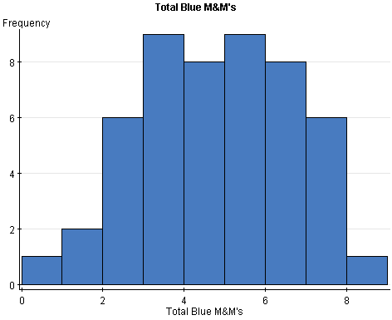
Bootstrap [Efron 1979]
Quantify accuracy of a sample estimator f()
can’t compute f (X)
as we don’t have X
Distribution X
f (X)
random
sample
|S| = N
S
f (S)
what is f(S)’s error?
sampling
with
replacement
S₁
f (S₁)
…
…
S_{k}
f (S_{k})
estimator: mean(f(S_{i}))
error, e.g.: stdev(f(S_{i}))
|S_{i}| = N

Slide 26
Bootstrap
Quantify accuracy of a query on a sample table
Original
Table
T
Q(T)
Q(T) takes too long!
sample
|S| = N
S
Q(S)
what is Q(S)’s error?
sampling
with
replacement
S₁
Q (S₁)
…
…
S_{k}
Q (S_{k})
estimator: mean(f(S_{i}))
error, e.g.: stdev(f(S_{i}))
|S_{i}| = N

Slide 27
Bootstrap
Bootstrap treats Q as a black-box
  Can handle (almost) arbitrarily complex queries including UDFs!
Embarrassingly Parallel
Uses too many cluster resources
S₁
Q (S₁)
…
…
S_{k}
Q (S_{k})

Slide 28
Error Estimation
1. CLT-based closed forms:
Fast but limited to simple aggregates
2. Bootstrap (Monte Carlo simulation):
Expensive but general
3. Analytical Bootstrap Method (ABM):
Fast and general
  (some restrictions, e.g. no UDF, some self-joins, ...)
Notes:
The basic idea of ABM is to annotate a tuple in the database with an integer-valued random variable that represents the possible multiplicity with which this tuple would appear in the simulated datasets generated by bootstrap. The small annotated database so obtained from the initial sample is called probabilistic multiset database (PMDB for short).

Slide 29
Analytical Bootstrap Method (ABM)
The Analytical Bootstrap: A New Method for Fast Error Estimation in Approximate Query Processing, K. Zeng, G. Shi, B. Mozafari, C. Zaniolo, SIGMOD 2014
ABM is 2-4 orders of magnitude faster than simulation-based implementations of bootstrap
Bootstrap = (naïve) Bootstrap method
BLB = Bag of Little Bootstrap (BLB-10 = BLB on 10 cores)
ODM = On-Demand Materialization
ABM = Analytical Bootstrap Method

Slide 30
Main Challenges
How to accurately estimate the error?
What if the error estimate itself is wrong?
Given a storage budget, which samples to build & maintain to support a wide range of ad-hoc exploratory queries?
Given a query, what should be the optimal sample type and size that can be processed to meet its constraints?
Notes:
----- Meeting Notes (4/8/13 22:14) -----
decide on the optimal set of samples to support adhoc exploratory queries

Slide 31
Problem with Uniform Samples
Uniform Sample
ID | City | Age | Salary
1 | NYC | 22 | 50,000
2 | Ann Arbor | 25 | 120,242
3 | NYC | 25 | 78,212
4 | NYC | 67 | 62,492
5 | NYC | 34 | 98,341
6 | Ann Arbor | 62 | 78,453
ID | City | Age | Salary | Sampling Rate
3 | NYC | 25 | 78,212 | 1/3
5 | NYC | 34 | 98,341 | 1/3
SELECT avg(salary)
FROM table
WHERE city = ‘Ann Arbor’
Notes:
BlinkDB tries to solve this problem by maintaining multi-granular samples on input data.
BlinkDB not only maintains samples across different dimensions, but also across a number of resolutions.

Slide 32
Problem with Uniform Samples
Larger
Uniform Sample
ID | City | Age | Salary | Sampling Rate
3 | NYC | 25 | 78,212 | 1/3
5 | NYC | 34 | 98,341 | 1/3
ID | City | Age | Salary
1 | NYC | 22 | 50,000
2 | Ann Arbor | 25 | 120,242
3 | NYC | 25 | 78,212
4 | NYC | 67 | 62,492
5 | NYC | 34 | 98,341
6 | Ann Arbor | 62 | 78,453
ID | City | Age | Salary | Sampling Rate
3 | NYC | 25 | 78,212 | 2/3
5 | NYC | 34 | 98,341 | 2/3
1 | NYC | 22 | 50,000 | 2/3
2 | Ann Arbor | 25 | 120,242 | 2/3
SELECT avg(salary)
FROM table
WHERE city = ‘Ann Arbor’
Notes:
BlinkDB tries to solve this problem by maintaining multi-granular samples on input data.
BlinkDB not only maintains samples across different dimensions, but also across a number of resolutions.

Slide 33
Stratified Samples
Stratified Sample on City
ID | City | Age | Salary
1 | NYC | 22 | 50,000
2 | Ann Arbor | 25 | 120,242
3 | NYC | 25 | 78,212
4 | NYC | 67 | 62,492
5 | NYC | 34 | 98,341
6 | Ann Arbor | 62 | 78,453
ID | City | Age | Salary | Sampling Rate
3 | NYC | 67 | 62,492 | 1/4
5 | Ann Arbor | 25 | 120,242 | 1/2
SELECT avg(salary)
FROM table
WHERE city = ‘Ann Arbor’
AND age > 60
Notes:
BlinkDB tries to solve this problem by maintaining multi-granular samples on input data.
BlinkDB not only maintains samples across different dimensions, but also across a number of resolutions.

Slide 34
Target Workload
Real-time latency is valued over perfect accuracy: ≤ 10 sec for interactive experience
Exploration is ad-hoc
Columns queried together (i.e., Templates) are stable over time
User defined functions (UDF) must be supported: 43.6% of Conviva’s queries
Data is high-dimensional & skewed: 100+ columns
Notes:
Real-time latency is valued perfect accuracy
Adhoc: Queries are not known in advance!
Popular column sets are stable!
UDFs are common
Curse of dimensionality
Skewed data
Accuracy Guarantees are needed

Slide 35
Which Stratified Samples to Build?
For n columns, 2^{n} possible stratified samples
Modern data warehouses: n ≈ 100-200
BlinkDB Solution: Choose the best set of samples by considering
Columns queried together
Data distribution
Storage costs

Slide 36

Experimental Setup
Conviva: 30-day log of media accesses by Conviva users. Raw data 17 TB, partitioned this data across 100 nodes
Log of 17,000 queries (a sample of 200 queries had 17 templates).
50% of storage budget: 8 Stratified Samples
Notes:
A company that manages 3.5 billion streams from premium content providers such as hbo, espn, yahoo over the internet

Slide 37
Sampling Vs. No-Sampling
Fully
Cached
Partially
Cached
Notes:
Simple average query with a filtering predicate on the “date” column (dt) with a GROUP BY on the “city” column. Using BlinkDB, specifying 1% error bound and 95% confidence, we ran this query on 250GB and 750GB of data (i.e., 5 and 15 days worth of logs, respectively) on a 100-node cluster. We repeated each query 3 times, reporting the average response time.

Slide 38
BlinkDB: Evaluation
Notes:
Simple average query with a filtering predicate on the “date” column (dt) with a GROUP BY on the “city” column. Using BlinkDB, specifying 1% error bound and 95% confidence, we ran this query on 250GB and 750GB of data (i.e., 5 and 15 days worth of logs, respectively) on a 100-node cluster. We repeated each query 3 times, reporting the average response time.

Slide 39
BlinkDB: Evaluation
200-300x
Faster!
Notes:
simple average query with a filtering predicate on the date column (dt) with a GROUP BY on the city column. on BlinkDB with a 1% error bound at 95% confidence. We ran this query on 250GB and 750GB of data (i.e., 5 and 15 days worth of logs, respectively) on a 100-node cluster. We repeated each query 3 times, reporting the average response time in

Slide 40
Outline
BlinkDB: Approximate Query Processing
Verdict: Database Learning

Slide 41
Verdict:
DB Learning: A DB that Gets Faster as It Gets More Queries!
(Work In Progress)

Slide 42
Stochastic Query Planning
Traditoinal Query Planning
Efficiently access all relevant tuples
Choose a single query plan out of many equivalent plans
Access a small fraction of tuples
Pursue multiple plans (not necessarily equivalent)
Learn from past query results!
Notes:
The reason is that alsmost all the optimizations we’ve come up with over the past 30+ years are based on two pieces of conventional wisdom:
1.
2.

Slide 43
2. Pursue multiple, different plans
Q: Avg income per different health conditions
Compute various approximations to re-calibrate the original estimate and boost accuracy
Sampling-based estimates | Uniform / Stratified Samples
Column-wise correlations | Between age and income
Tuple-wise correlations | Between Detroit and nearby cities
Temporal correlations | Between health of the same people when they were 35 and 40
Regression models | Marginal or conditional distribution of health condition

Slide 44
3. Learn from past queries
Each query is a new evidence
=> Use smaller samples
DB Learning: DB gets smarter over time!
Q1: select avg(salary)
from T where age>30
Time
Q2: select avg(salary)
from T where job=“prof”
Q3: select avg(commute)
from T where age=40

Slide 45
Verdict: A Next Generation AQP System
Verdict gets smarter over time as it learns from and uses past queries!
In machine learning, models get smarter with more training data
In DB learning, database gets smarter with more queries!
Verdict can use samples that are 10-100x smaller than BlinkDB, while guaranteeing (similar) accuracy

Slide 46
Conclusion
Approximation is an important means to achieve interactivity in the big data age
Ad-hoc exploratory queries on an optimal set of multi-dimensional stratified samples converges to lower errors 2-3 orders of magnitude faster than non-optimal strategies
Notes:
----- Meeting Notes (4/8/13 12:52) -----
ELP
explicit mention

Slide 47
Conclusion (cont.)
Once you open the door of approximations, there’s no end to it!
Numerous new opportunities that wouldn’t make sense for traditional DBs
    Pursuing non-equivalent plans!
3. DB Learning: Databases can learn from past queries (not just reusing cached tuples!)

