Slide 1
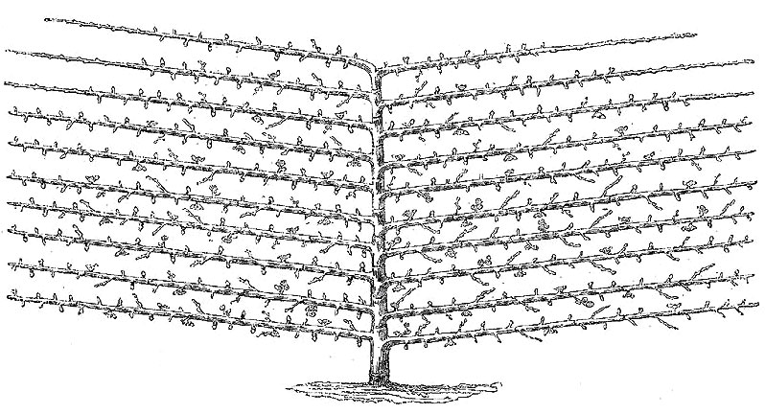
drawing: Abrahami
Espaliers A Visualization Method for Big Data
Max Robinson*
Gustavo Glusman*
Greg Eley*
Joseph G. Vockley*
John E. Niederhuber*
Institute for Systems Biology
Scimentis, LLC
Inova Translational Medicine Institute

Slide 2
Big Data: The Object/Attribute Matrix
<a_{1j}, …, a_{mj}>
n Attributes
A =
a₁₁
a_{1n}
<a_{i1}, …, a_{in}>
a_{ij} ≥ 0
Non-negative!
m Objects
Example: text mining
a_{ij} = Occurrences of word j in text i
a_{m1}
a_{mn}
Population genetics (genotypes)
Gene expression matrix
Social network graph
Notes:
Highlight non-negative data

Slide 3
1. Population genetics: genotypes 1000 Genomes, phase 3 genotypes
n = 212,961 variant positions (1%, AC ≥ 5)
A =
a₁₁
a_{1n}
m = 2,504
DNA samples
a_{ij} = sample i’s genotype at variant j
81,029,508 of the a_{ij} > 0 (15%)
a_{m1}
a_{mn}
Variant position j: ACG1ATACC2CAAGAGATT3TCGAGT4
Variant allele: ACGCATACCACAAGA GATGTCGAGTC
Reference Sequence: ACGTATACCTCAAGAGATTTTCGAGTGCGTCGA
i = 3
Maternal allele: ACGCATACCACAAGA GAT T TCGAGG
Paternal allele: AC TATAC ACAAGA GAT GTCGAG G
Genotype: 1 2 1 0
a₃₁ a₃₂ a₃₃ a₃₄

Slide 4
1. Population genetics: genotypes 1000 Genomes, phase 3 genotypes
n = 212,961 variant positions (1%, AC ≥ 5)
A =
a₁₁
a_{1n}
m = 2,504
DNA samples
a_{ij} = sample i’s genotype at variant j
81,029,508 of the a_{ij} > 0 (15%)
a_{m1}
a_{mn}
Σ
a₊₁ allele count (AC) a_{+n}
Variant position j: ACG1ATACC2CAAGAGATT3TCGAGT4
Variant allele: ACGCATACCACAAGA GATGTCGAGTC
Reference Sequence: ACGTATACCTCAAGAGATTTTCGAGTGCGTCGA
i = 3
Maternal allele: ACGCATACCACAAGA GAT T TCGAGG
Paternal allele: AC TATAC ACAAGA GAT GTCGAG G
Genotype: 1 2 1 0
a₃₁ a₃₂ a₃₃ a₃₄

Slide 5
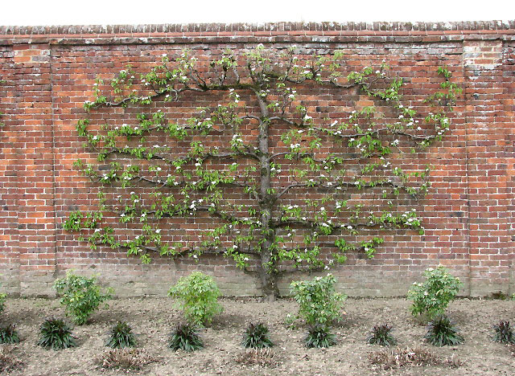
The Espalier Concept
Espaliered fruit tree
Phylogenetic tree
Attributes
time
Objects
photo courtesy of Evelyn Simak
“Espalier coordinate”
The correlation structure of a data matrix
places objects and attributes in related positions
along a shared coordinate.

Slide 6
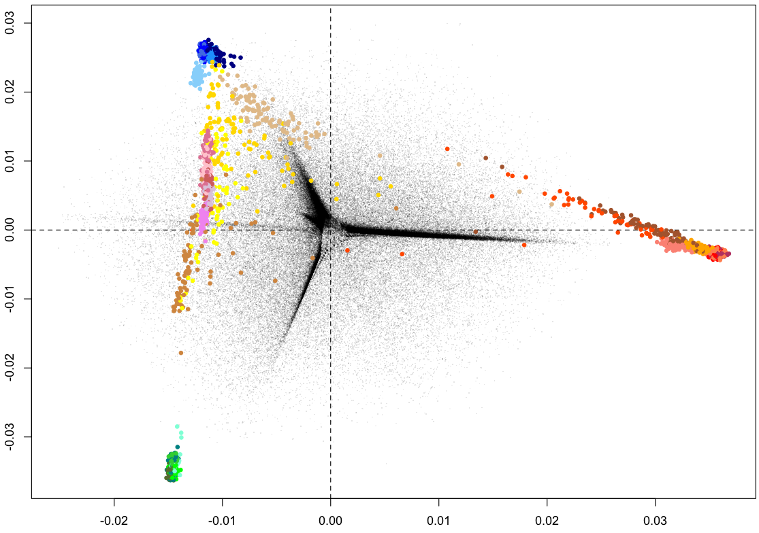
Population Structure via Principal Component Analysis
Attributes
(variants)
Population
PC2
Objects (DNA samples)
Principal Component 1 (PC1)

Slide 7
From PCA to Espalier Plots
5000
Attributes
1000
Population
500
100
PC2
50
Allele Count (log)
10
5
Objects
Principal Component 1 (PC1)

Slide 8
From PCA to Espalier Plots
5000
Attributes
1000
Population
500
100
50
Allele Count (log)
10
5
Objects
Principal Component 1 (PC1)

Slide 9
From PCA to Espalier Plots
5000
Common,
ancient
loading (weight)
1000
Population
500
PCA is capturing
genetic drift:
differential loss of
common variants by
separate populations
100
50
Allele Count (log)
10
Rare,
recent
5
Principal Component 1 (PC1)

Slide 10
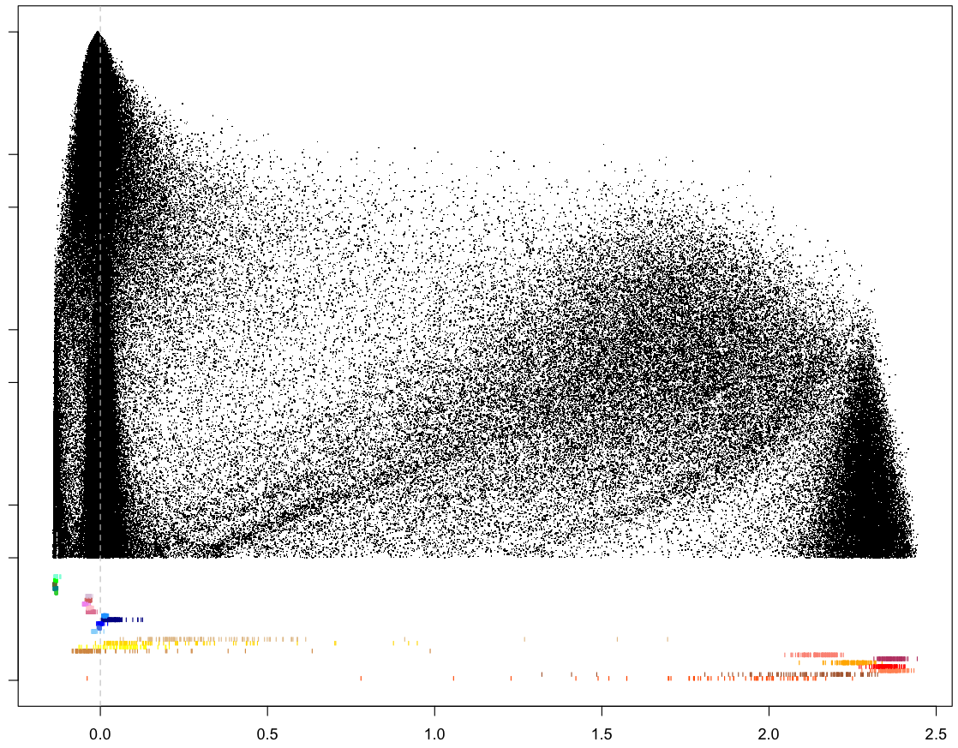
Espaliers Realized: Scaled SVD
5000
Population
1000
500
100
50
Allele Count (log)
10
5
Out-of-African
African
Espalier Component 1 (EC1)

Slide 11
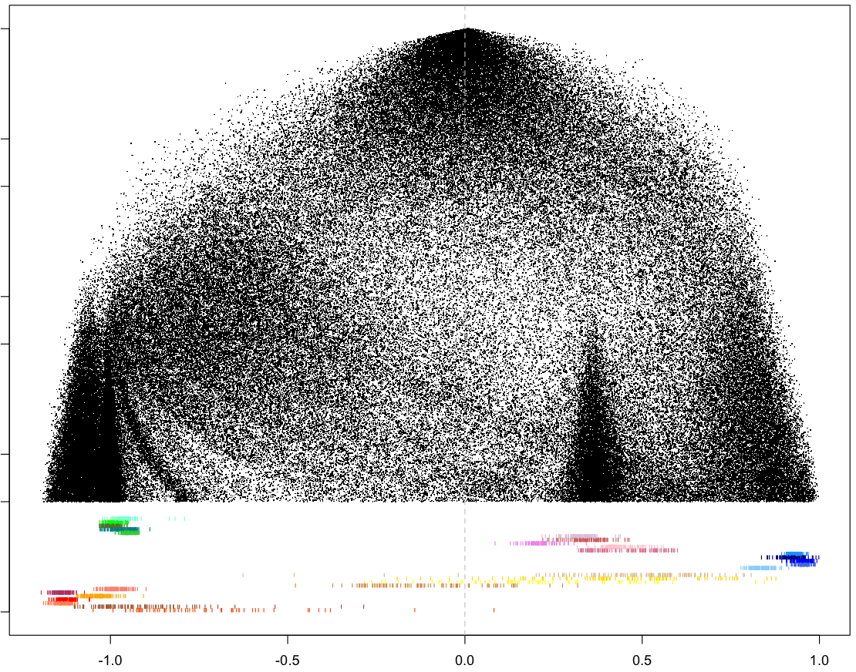
Espaliers Realized: Scaled SVD
5000
ScaledSVD is capturing
population-specific
mutations
Population
1000
500
100
50
Allele Count (log)
10
5
East Asian
Indo-European
African
Espalier Component 2 (EC2)

Slide 12
PCA Scaled SVD
a_{*s}
a_{i*}
w_{*s}
a_{*t}
w_{i*}
w_{*t}
w_{i*}
Normalize A → Z:
z_{ij} = (a_{ij} –μ_{j})/σ_{j}
mean(z_{*j}) = 0
variance(z_{*j}) = 1
Singular Value Decomp.
Z = U diag(λ^{1/2}) V⁻¹
Column k of U: PC_{k}
Column k of V: “loadings”
a_{j*}
Scale A → W
W = diag(d_{m}) A diag(1/d_{n})
|w_{i*}| = |w_{j*}| all 1 ≤ i,j ≤ m
|w_{*i}| = |w_{*j}| all 1 ≤ s,t ≤ n
Singular Value Decomp.
W = U diag(λ^{1/2}) V⁻¹
Column k of U: EC_{k}(Objects)
Column k of V: EC_{k}(Attributes)
Project onto tangent space
u_{k} = u’_{k+1}/u’₁
v_{k} = v’_{k+1}/v’₁
Simultaneous Scaling
same
u_{k}
u’_{k+1}
u’₁
Projection

Slide 13
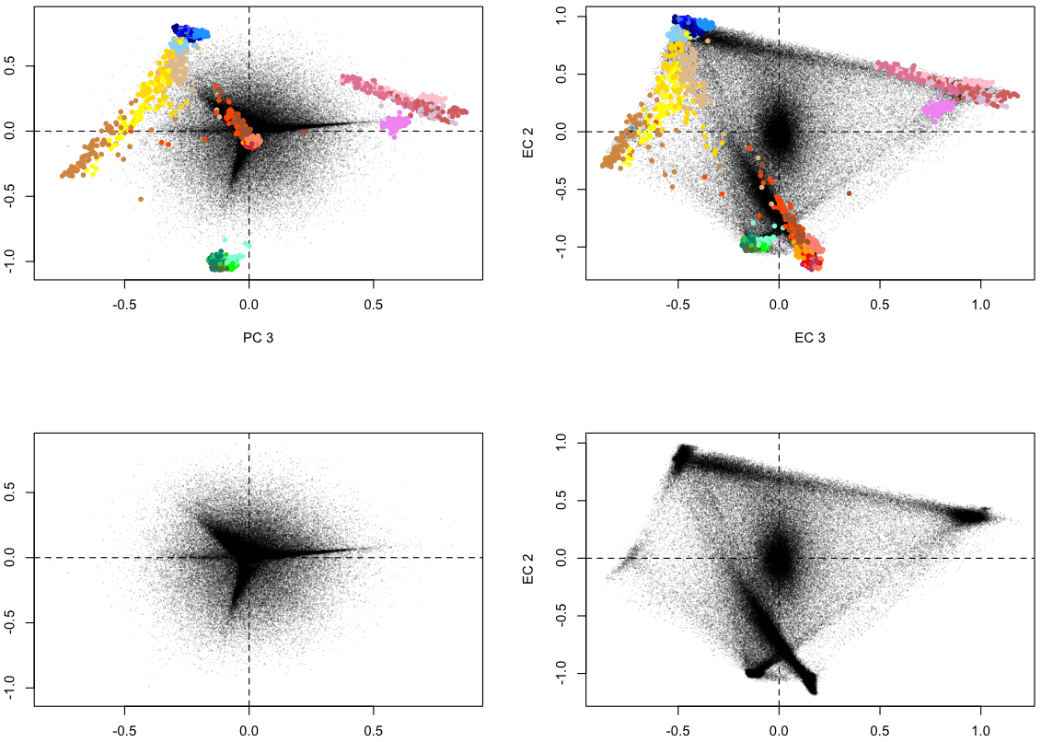
PCA vs Scaled SVD biplots
Population
PC 2
EC 2
PCA
Scaled SVD
PC 2
EC 2
PC 3
EC 3

Slide 14
2. Gene expression data Illumina Bodymap 2.0 (GEO series GSE30611)
n= 16 tissue samples
A =
a₁₁
a_{1n}
a_{ij} = Detections of gene i in tissue j
304,756 of the a_{ij} > 0 (64%)
m = 29,665 genes
a_{m1}
a_{mn}
Object: Amount of 1 gene in 16 tissue samples
Attribute: Amount of 29,665 genes in 1 tissue sample

Slide 15
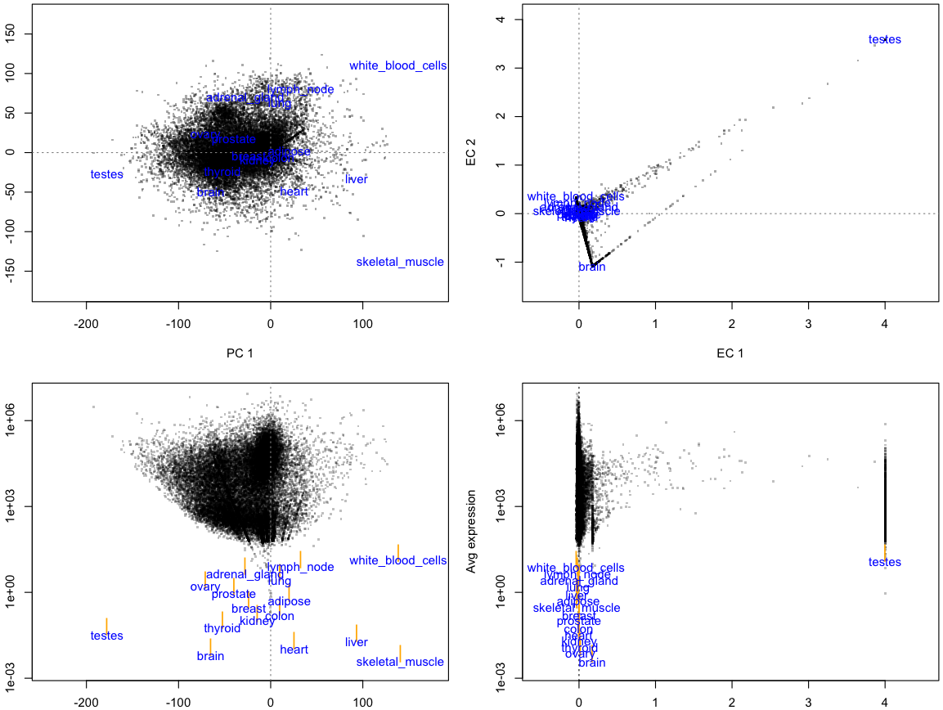
PCA, Scaled SVD Comparison
Illumina Bodymap 2.0
PC 2
EC 2
biplots
PC 1
EC 1
Avg expression
Avg expression
Espalier plots
PCA
Scaled SVD

Slide 16
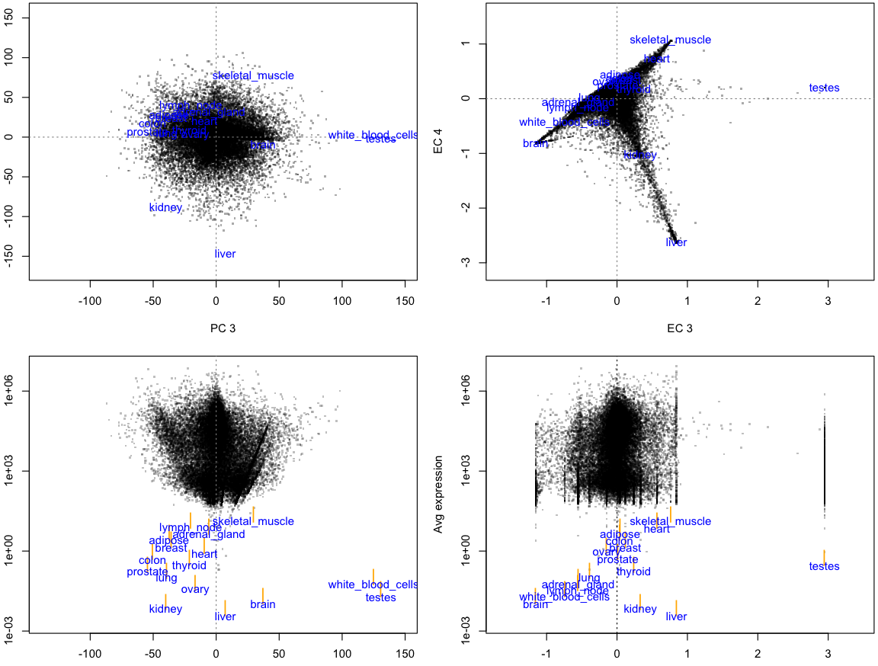
PCA, Scaled SVD Comparison
Illumina Bodymap 2.0
PC 4
EC 4
biplots
PC 3
EC 3
Avg expression
Avg expression
Espalier plots
PCA
Scaled SVD

Slide 17
3. Social Network Graph
The Flickrverse (G. Glusman, 2005)
n= 90,403 users
A =
a₁₁
a_{1n}
a_{ij} = User i contacted user j (0, 1)
609,170 of the a_{ij} > 0 (.0075%)
n = 90,403 users
a_{m1}
a_{mn}
Object: Which other users’ photos user i contacted
Attribute: Which other users contacted user i’s photos
Standard PCA’s normalization fills this matrix; not enough memory.
Scaled SVD is a sparse method, plenty of memory.

Slide 18
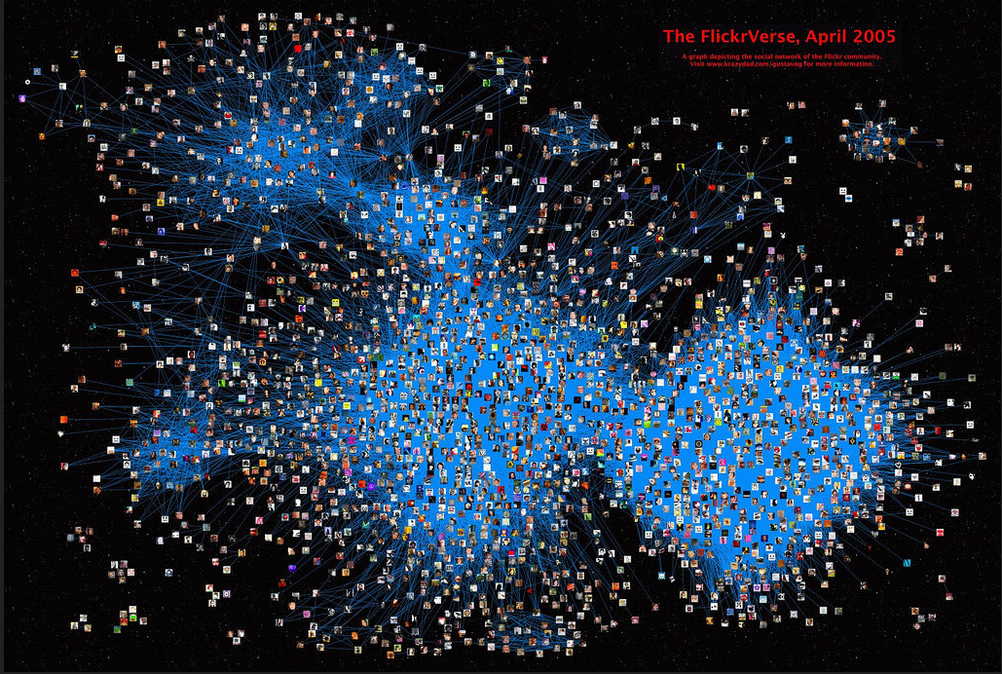
The Flickrverse (G. Glusman, 2005)
Only 2,367 of the 90,404 nodes shown (2.6%)

Slide 19
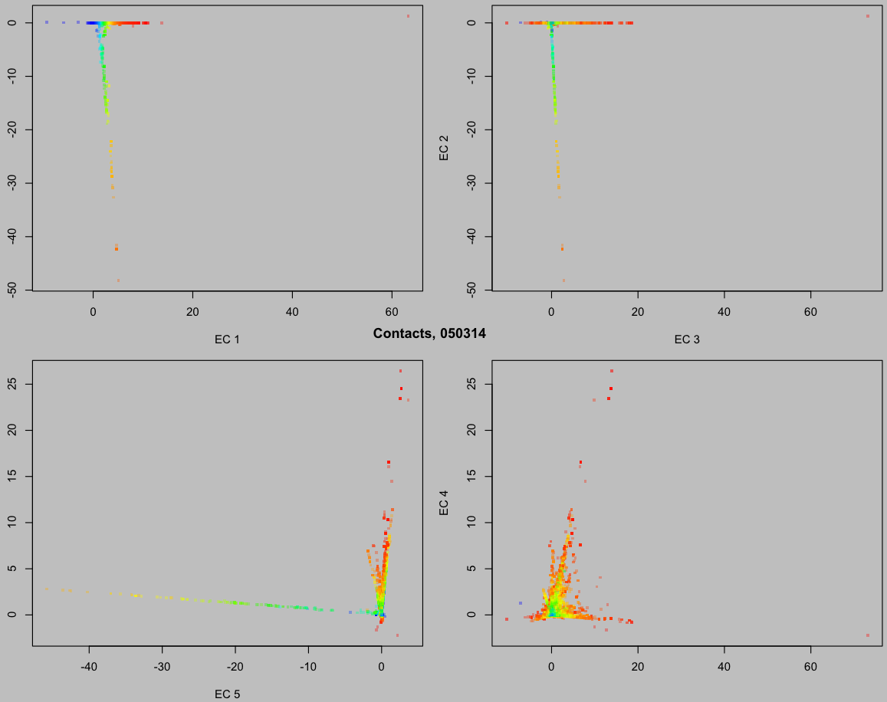
The Flickrverse, analyzed by Scaled SVD
Colors are an
EC1 rainbow
EC2
EC1
EC3
Each EC
shows
structure
in graph
EC4
EC5

Slide 20
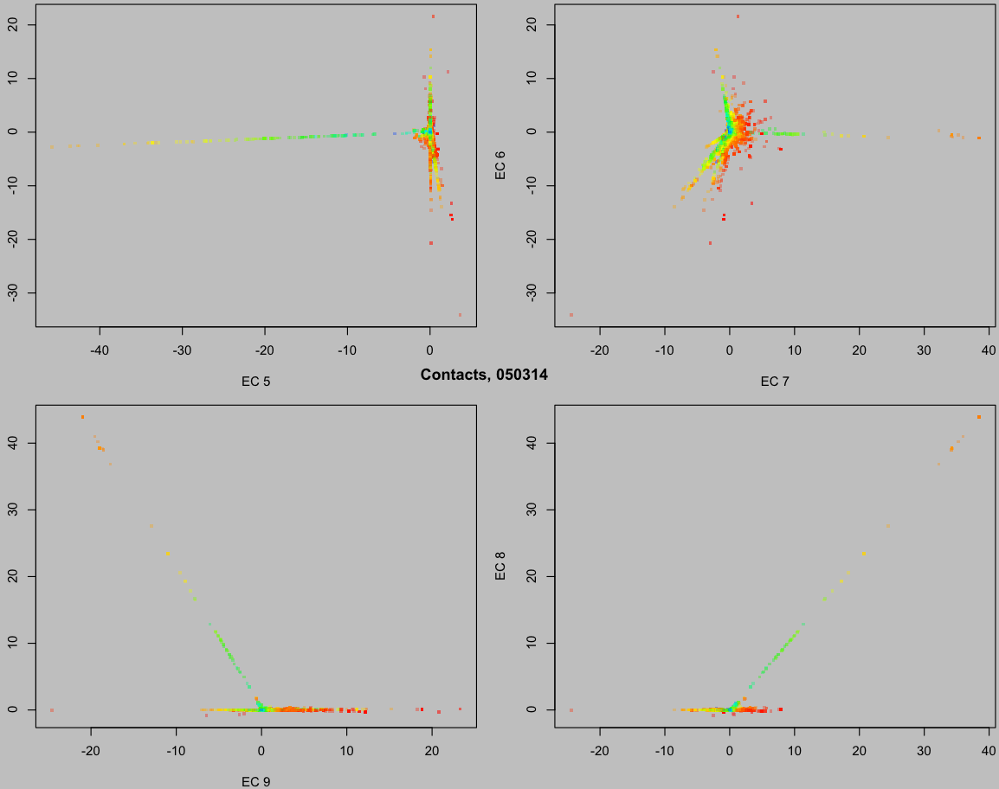
The Flickrverse, analyzed by Scaled SVD
Colors are an
EC1 rainbow
EC6
EC5
EC7
Each EC
shows
structure
in graph
EC8
EC9

Slide 21
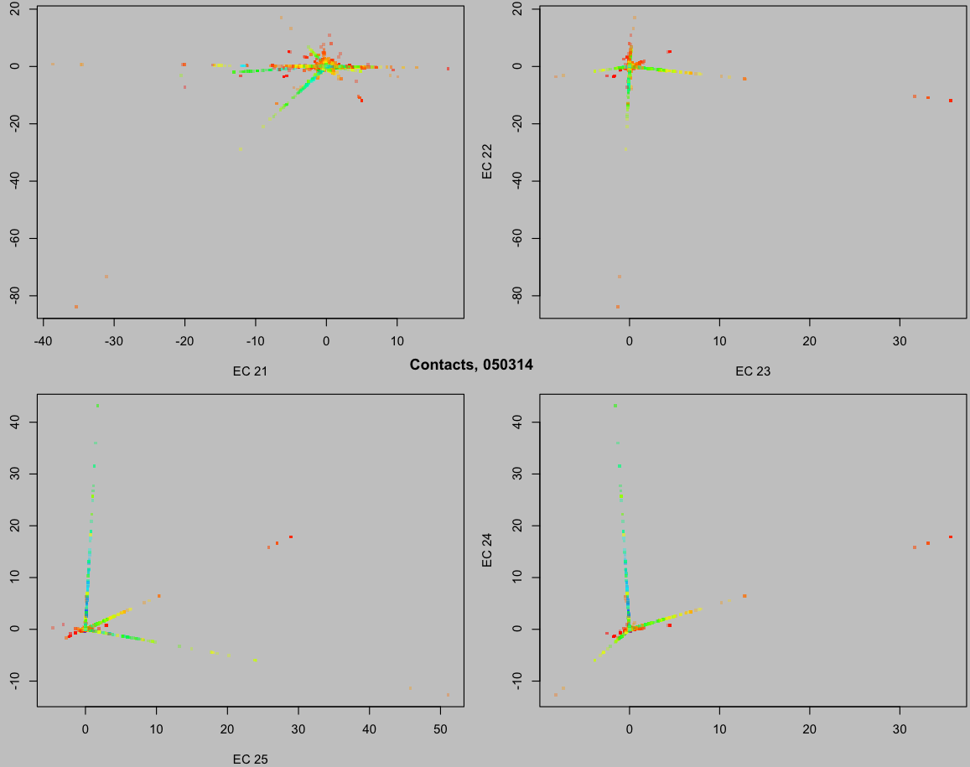
The Flickrverse, analyzed by Scaled SVD
Colors are an
EC1 rainbow
EC22
EC21
EC23
Each EC
shows
structure
in graph
EC24
EC25

Slide 22
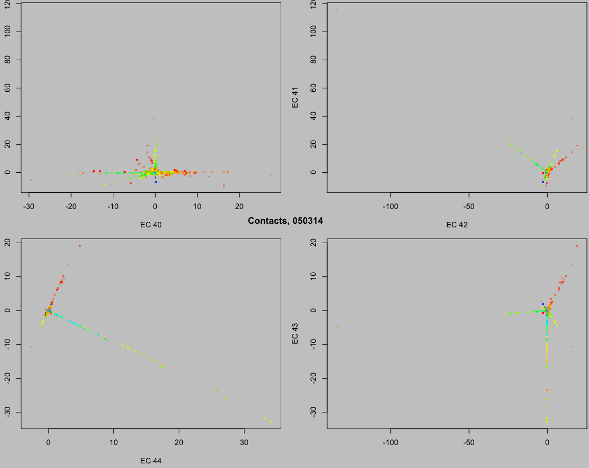
The Flickrverse, analyzed by Scaled SVD
Colors are an
EC1 rainbow
EC41
EC40
EC42
Each EC
shows
structure
in graph
EC43
EC44

Slide 23
Summary
Scaled SVD--linear data reduction method
Designed for non-negative data
Geometric rationale (Espaliers)
Big Data: preserves sparseness of matrix
Appropriate first step for co-clustering
Transpose of matrix yields identical result
Axis orientation, ordering properties of SVD, like PCA
Qualitatively different results from PCA
Espalier Plots
One espalier coordinate vs. row, column sums
Grouped Objects, Attribute span data quantity range
Espalier coordinate biplots

Slide 24
Acknowledgements
Thanks to my co-authors:
Gustavo Glusman, Greg Eley, Joseph G. Vockley,
and John E. Niederhuber
and to these members of the Hood and Shmulevich groups at ISB for
helpful discussions of this work:
Nigel Clegg, Anna Stittrich, Theo Knijnenberg,
Bill Longabaugh, Alissa Severson, Chris Lausted,
and Ilya Shmulevich
Thanks especially to our collaborators at
The Inova Translational Medicine Institute
for the opportunity to purse this research!

