Slide 1
2015 JSM Session
Big Data: Modeling, Tools, Analytics, & Training
Organizer: Ivo D. Dinov, Statistics Online Computational Resource (SOCR), Michigan
Moderator/Chair: Robin Jeffries, CSU Chico
Logistics:
Date/Time: Mon, 8/10/2015, 10:30 AM - 12:20 PM
Venue: Washington State Convention Center, CC-606
Session: #211347, Sponsor: Statistical Computing
Speakers and Topics
Ivo Dinov (Michigan), Management, Modeling & Analytic Challenges of Big Biomedical Data
Max Robinson & Gustavo Glusman, ISB ESPALIERS: A visualization method for Big Data
Moo K. Chung (Wisconsin), The computational challenges of constructing and visualizing large-scale brain networks
Ravi Madduri, Argonne/Chicago, Big Data Services: Globus Online, Galaxy, GridFTP
Barzan Mozafari, Large-scale Data Intensive Systems, Big Data, Interactive Data Processing
http://wiki.socr.umich.edu/index.php/SOCR_Events_JSS_2015

Slide 2
Management, Modeling & Analytic Challenges of Big Biomedical Data
Ivo D. Dinov
Statistics Online Computational Resource
University of Michigan
www.SOCR.umich.edu

Slide 3
Outline
Availability, Sharing, Aggregation and Services
Classical Data Science vs. Innovative Big Data Analytics
Amateur Scientists vs. “Experts”
Data Scientists vs. Practitioners
Domain-specific vs. Trans-disciplinary knowledge
Commercial vs. Open-source Resourceome
Rapid Big Data Evolution
Big Data IT proliferation
Data democratization
Big Data is incredibly time, space, protocol, context sensitive
Big Data Science Training (opportunities and challenges)
Notes:
10¹⁵ Peta-Byte data demands

Slide 4
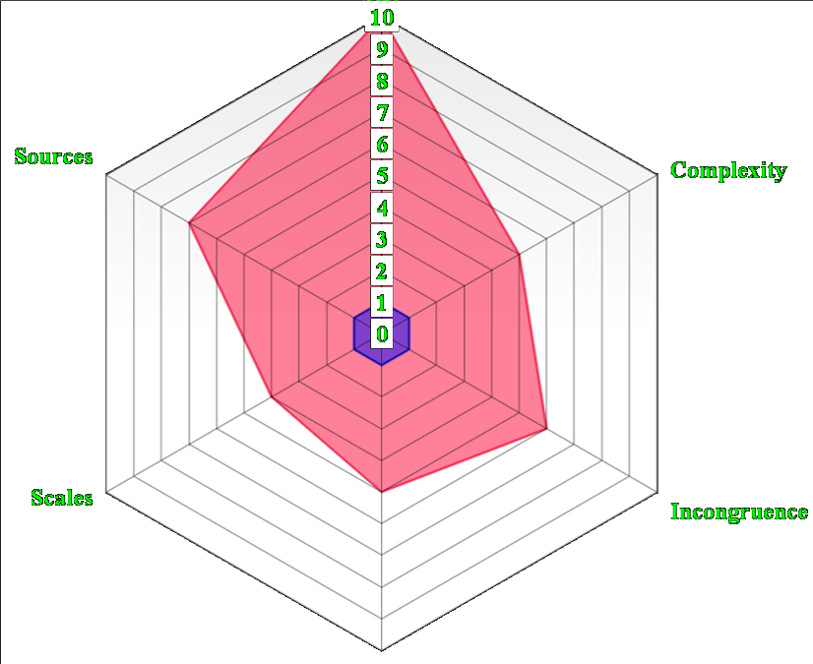
Characteristics of Big Data
Size
Example: analyzing observational data of 1,000’s Parkinson’s disease patients based on 10,000’s signature biomarkers derived from multi-source imaging, genetics, clinical, physiologic, phenomics and demographic data elements.
Software developments, student training, service platforms and methodological advances associated with the Big Data Discovery Science all present existing opportunities for learners, educators, researchers, practitioners and policy makers
Expected Increase
Incompleteness
Mixture of quantitative & qualitative estimates Dinov, et al. (2014)
Notes:
What is Big Data? Big data is very different from traditional (small) data due to the exotic challenges it presents and because of its potential to revolutionize our understanding of the world around us. There are 6 characteristics that make Big Data unique. These 6-dimensions (6Ds) of Big Data are defined by its unique attributes: (1) Size – the volume of data exceeds standard storage, memory and computational capabilities, (2) Incongruency – samples, cases and observations in the data may be highly non-homologous, which requires special treatment during the data analytics phase, (3) Incompleteness – Big Data may be sparse with (random and non-random causes of) missing values due to the en masse nature of generation and collection of data elements, (4) Complexity – as the dimension of the data increases distance metrics between observations become degenerate (curse of dimensionality) leading to considerable computational and interpretation challenges, (5) Multi-scale – Big Data frequently includes observations from micro to meso to macro levels, across time, space and frequency spectra, and (6) Multi-source – numerous digital, analogous and mixed data is produced by devices and instruments demand integration (fusion) of relevant data within and beyond the scope of any specific research study. These 6Ds allow us to begin the processes of model, algorithm and tool development necessary to cope with the specific challenges that make “standard scientific methods” impractical for Big Data. Big Data science is team-based and highly trans-disciplinary. It requires diverse, broad, and complementary expertise, specialized training, continuous development efforts, high-throughput analytics, and powerful techniques for data interrogation. The scope of Big Data challenges are illustrated by the problem of analyzing observational data of 1,000’s Parkinson’s disease patients based on 10,000’s signature biomarkers derived from multi-source imaging, genetics, clinical, physiologic, phenomics and demographic data elements. Similar data-driven exploratory and confirmatory analytic examples can be demonstrated in other disciplines. Software developments, student training, service platforms and methodological advances associated with the Big Data Discovery Science all present existing opportunities for learners, educators, researchers, practitioners and policy makers
http://www.onlinecharttool.com/graph?selected_graph=radar

Slide 5
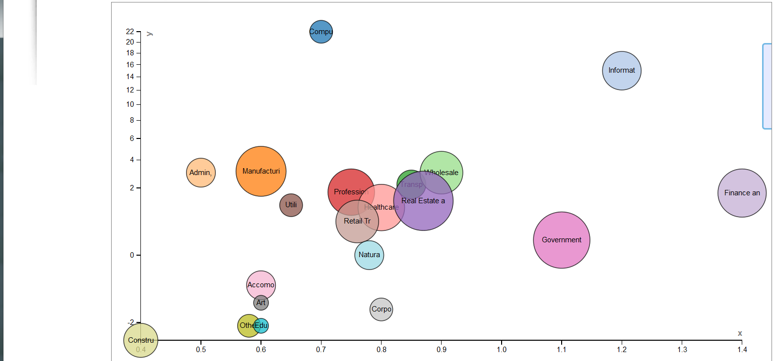
Availability, Sharing, Aggregation & Services
There will be over 10 billion mobile-connected devices in 2016; i.e., there will be 1.3 mobile devices per capita
Industry Sector
Computer & Electronic Products
Information Services
Manufacturing
Admin, support & waste management
Transportation & Warehousing
Wholesale Trade
Professional Services
Healthcare Providers
Real Estate and Rental
Finance and Insurance
Utilities
Retail Trade
Government
Accomodation & Food
Arts & Enterntainment
Corporate Management
Other Services
Construction
Education Services
Natural Resources
Bubble Size ~ Relative size of GDP
Percent Growth
U.S. Bureau of Labor Statistics
McKinsey Global Institute
Big Data Value Potential Index
Notes:
Name time Index x y size Computer & Electronic Products 1 1 0.7 22 0.2 Information Services 1 2 1.2 15 0.5 Manufacturing 1 3 0.6 3.1 0.8 Admin, support & waste management 1 4 0.5 3 0.3 Transportation & Warehousing 1 5 0.85 2.2 0.3 Wholesale Trade 1 6 0.9 3 0.6 Professional Services 1 7 0.75 1.75 0.7 Healthcare Providers 1 8 0.8 1 0.7 Real Estate and Rental 1 9 0.87 1.3 1.1 Finance and Insurance 1 10 1.4 1.7 0.75 Utilities 1 11 0.65 1.1 0.2 Retail Trade 1 12 0.76 0.5 0.6 Government 1 13 1.1 0.1 1 Accomodation & Food 1 14 0.6 -0.4 0.3 Arts & Enterntainment 1 15 0.6 -1 0.1 Corporate Management 1 16 0.8 -1.3 0.2 Other Services 1 17 0.58 -2.2 0.2 Construction 1 18 0.4 -3.2 0.4 Education Services 1 19 0.6 -2.2 0.1 Natural Resources 1 20 0.78 0 0.3

Slide 6
Democratization of Big Data Science
Doctorate training is not mandatory nor does it guarantee appropriate Big Data expertise
Lower barriers of entry
Demand for constant “Continuing Education” and self-training
Dichotomy between theoretical and empirical sciences
Differences between fundamental knowledge and experimental skills (big data properties closely approximate core scientific principles)
Notes:
10¹⁵ Peta-Byte data demands

Slide 7
Domain-specific vs. Trans-disciplinary knowledge
Math/Stats
Physics
Biology
Chemistry
....
Basic
Sciences
Big Data
Science
Applied
Sciences
Computational
Sciences
Medical Sciences
Social Sciences
Environmental Sciences
....
Engineering
Computer Science
Bioinformatics
Biomath/Biostats
....
Notes:
What is Big Data Science? Integration of knowledge, techniques, tools, data, and resources from Multiple disciplines

Slide 8
Big Data Resourceome
There is an explosion of open-data-science resources
www.data.gov
www.ncbi.nlm.nih.gov/gap
Spawning of a number of industries and enterprises blending proprietary and open-source data, code, documentation, expert-support, infrastructure and services
Big Data to Knowledge Initiative: www.BD2K.org
Google Cloud Platform (GCP)
Amazon Web Services (AWS)
Notes:
10¹⁵ Peta-Byte data demands

Slide 9
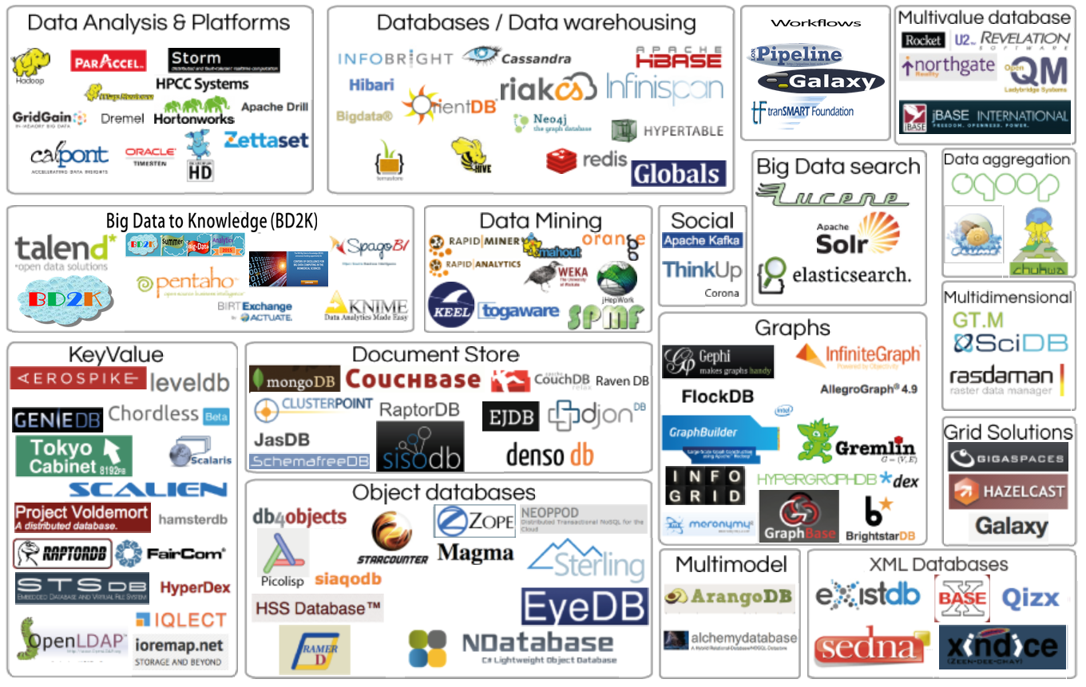
Big Data Analytics Resourceome
http://bd2k.org/BigDataResourceome.html
Notes:
http://bd2k.org/BigDataResourceome.html

Slide 10
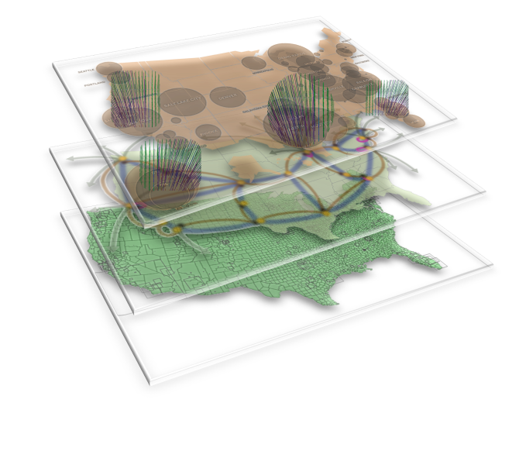
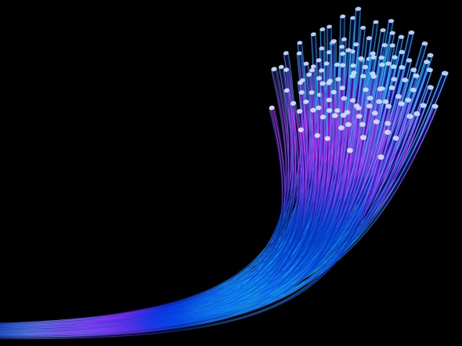
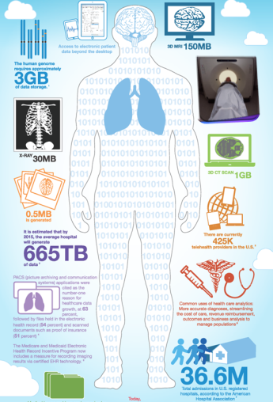
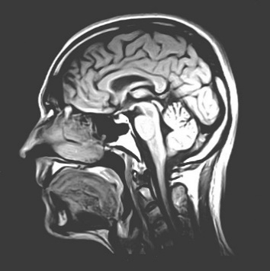
BD
I
K
A
Big Data | Information | Knowledge | Action
Raw Observations | Processed Data | Maps, Models | Actionable Decisions
Data Aggregation | Data Fusion | Causal Inference | Treatment Regimens
Data Scrubbing | Summary Stats | Networks, Analytics | Forecasts, Predictions
Semantic-Mapping | Derived Biomarkers | Linkages, Associations | Healthcare Outcomes
Notes:
Schematic

Slide 11
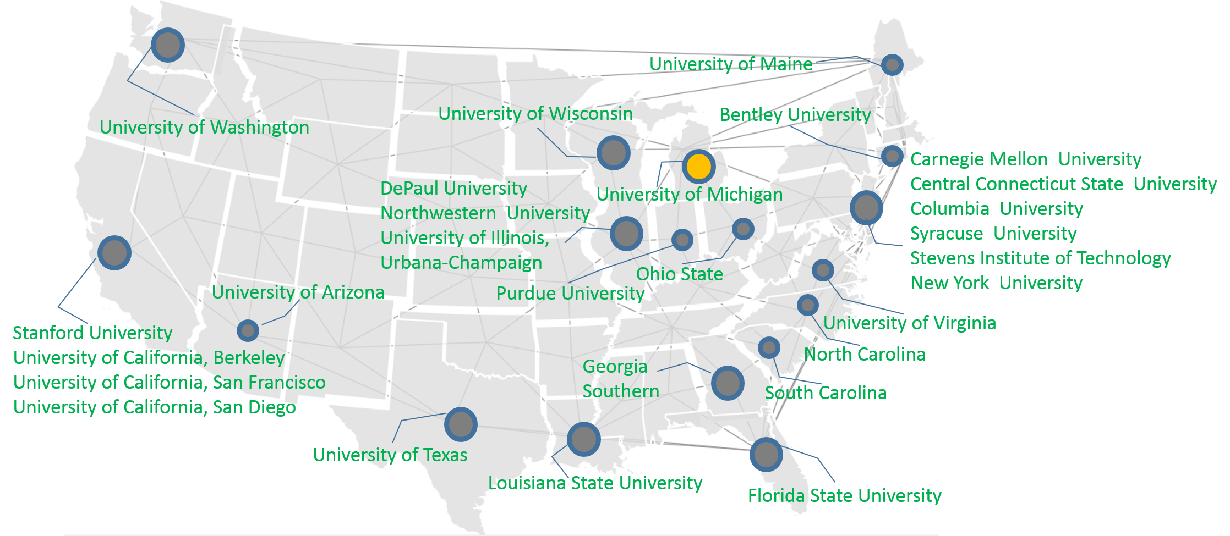
National Big Data to Knowledge (BD2K) Centers
Center for Causal Modeling and Discovery of Biomedical Knowledge from Big Data (U Pitt, Cooper, Bahar, Berg)
Center for Predictive Computational Phenotyping (U Wisconsin, Craven
National Center for Mobility Data Integration to Insight (The Mobilize Center) (Stanford, Delp)
KnowEng, a Scalable Knowledge Engine for Large-Scale Genomic Data The (U Illinois Urbana-Champaign, Han, Sinha, Sorg, Weinshilboum)
Center for Big Data in Translational Genomics (UC Santa Cruz, Haussler, Patterson)
Patient-Centered Information Commons (Harvard, Kohane)
Center of Excellence for Mobile Sensor Data-to-Knowledge (MD2K) (U Memphis, Kumar)
Center for Expanded Data Annotation and Retrieval (CEDAR) (Stanford, Musen)
A Community Effort to Translate Protein Data to Knowledge: An Integrated Platform (UCLA, Ping, Lindsey, Su, Watson)
ENIGMA Center for Worldwide Medicine, Imaging, and Genomics (USC, Thompson)
Big Data for Discovery Science (USC, Toga)
www.BD2K.org
Notes:
http://bd2k.org/BigDataResourceome.html

Slide 12
Kryder’s law: Exponential Growth of Data
Increase of
Imaging Resolution
← Time ←
Walter, Sci Am, 2005
storage doubles every 1.2 yrs
Computational power
double each 1.6 years
Data volume
Increases faster
than computational power
Dinov, et al., 2014
Notes:
Kryder's law, Chip Walter - Scientific American, 2005 - nature.com
On Average, Data storage doubles every 1.2 yrs, Computational power double each 1.6 years.

Slide 13
Big Data Challenges
Inference
High-throughput
Expeditive,
Adaptive
Modeling
Constraints, Bio,
Optimization,
Computation
Complexity
Volume,
Heterogeneity
Representation
Incompleteness
(space, time,
measure)

Slide 14
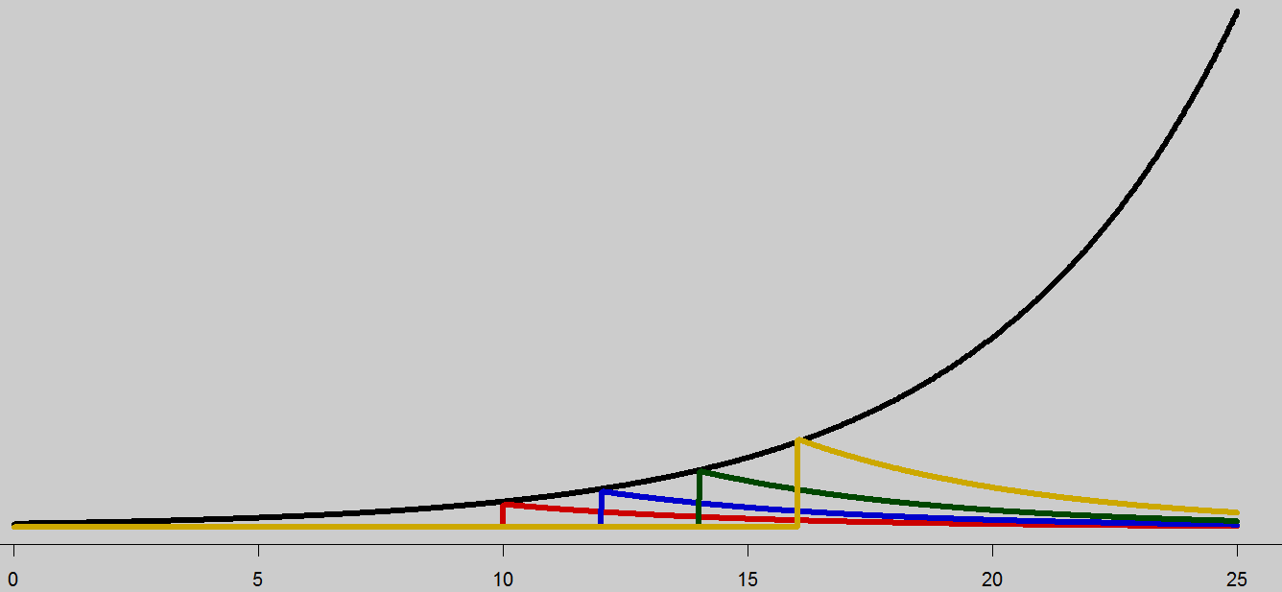
Energy & Life-Span of Big Data
Energy encapsulates the holistic information content included in the data (exponentially increasing with time), which may often represent a significant portion of the joint distribution of the underlying process
Life-span refers to the relevance and importance of the Data (exponentially decreasing with time)
Exponential Growth of Big Data (Size, Complexity, Importance)
Exponential Value Decay of Static Big Data
T=10
T=12
T=14
Time of Data Fixation
T=16
Data Fixation
Time Points
Time
http://www.aaas.org/news/big-data-blog-part-v-interview-dr-ivo-dinov

Slide 15
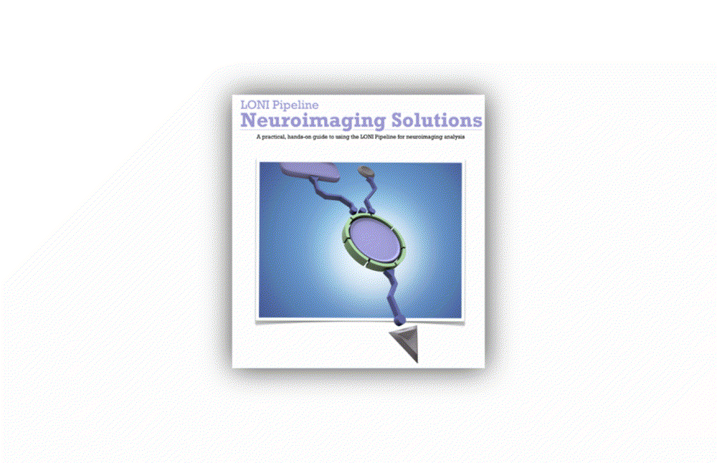
End-to-end Pipeline Workflow Solutions
Dinov, et al., 2014, Front. Neuroinform.; Dinov, et al., Brain Imaging & Behavior, 2013
Notes:
Big Data has intrinsically multi-dimensional characteristics …

Slide 16
End-to-end Pipeline Workflow Solutions
Dinov, et al., 2014, Front. Neuroinform.; Dinov, et al., Brain Imaging & Behavior, 2013
Notes:
Big Data has intrinsically multi-dimensional characteristics …

Slide 17
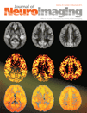
Neurodegenerative Disease Applications:
Imaging-Genetic Biomarker Interactions in Alzheimer’s Disease
Goals
Investigate AD subjects (age 55 – 65) using Neuroimaging Initiative (ADNI) database to understand early-onset (EO) cognitive impairment using neuroimaging and genetics biomarkers
Data
9 EO-AD and 27 EO-MCI
Derived 15 most impactful neuroimaging markers (out of 336 morphometry measures)
Obtained 20 most significant single nucleotide polymorphisms (SNPs) associated with specific neuroimaging biomarkers (out of 620K SNPs)
Approach
Global Shape Analysis (GSA) Pipeline workflow
Moon, Dinov et al., 2015, Psych. Investig.
Moon, Dinov et al., 2015, J Neuroimaging
Notes:
Imaging Pheno/Genotype Associations: Data

Slide 18
Results: AD Imaging-Genetic Biomarker Interactions
Identified associations between neuroimaging phenotypes and genotypes for the cohort of 36 EO subjects
Overall most significant associations:
rs7718456 (Chr 15) and L_hippocampus (volume)
rs7718456 and R_hippocampus (volume)
For the 27 EO-MCI’s, most significant associations
rs6446443 (Chr 4, JAKMIP1 janus kinase and microtubule interacting protein 1 gene) and R_superior_frontal_gyrus (volume)
rs17029131 (Chr 2) and L_Precuneus (volume)
Moon, Dinov et al., 2015, Psych. Investig.
Notes:
Imaging Pheno/Genotype Associations: Early Onset AD’s

Slide 19
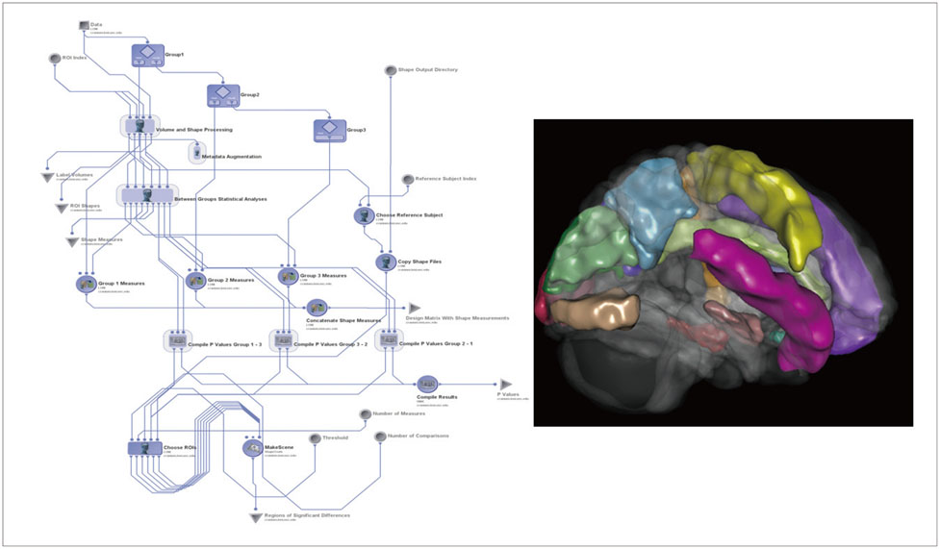
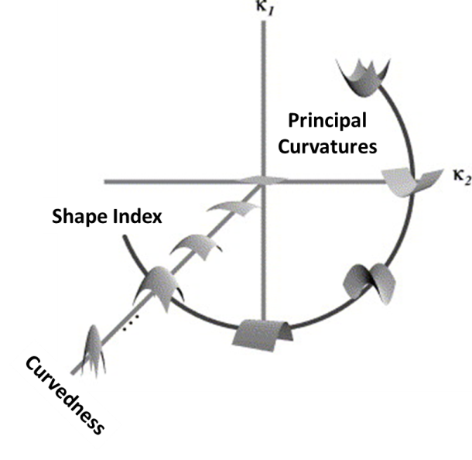
Results: AD Imaging-Genetic Biomarker Interactions
Shape Index | $SI$= $$\frac{2}{π}arctan$$ $$\left(\frac{κ_{2}+κ_{1}}{κ_{2}−κ_{1}}\right)$$ | $$−1≤SI≤1$$
Curvedness | $CV$=$\sqrt{\frac{κ_{1}^{2}+κ_{2}^{2}}{2}}$ $$0≤CV$$
Notes:
The global shape analysis (GSA) pipeline workflow and one example of a 3D scene output file indicating statistically significant (p-value<0.05) volumetric differences between the early-onset Alzheimer's disease and early-onset mild cognitive impairment cohorts. These scene files are generated for each group comparison and each shape or volume metric. Psychiatry Investig. 2015 Jan;12(1):125-135. http://dx.doi.org/10.4306/pi.2015.12.1.125

Slide 20
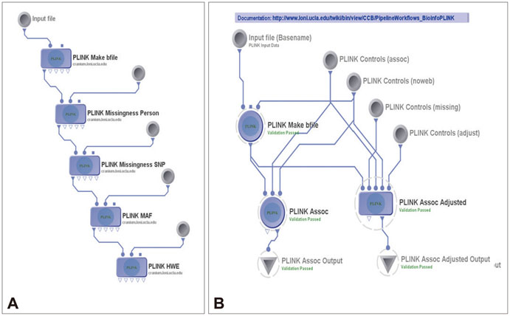
Results: AD Imaging-Genetic Biomarker Interactions
QC Protocol
QC Plink workflow
Genetic association study
Notes:
Imaging Pheno/Genotype Associations: Data

Slide 21
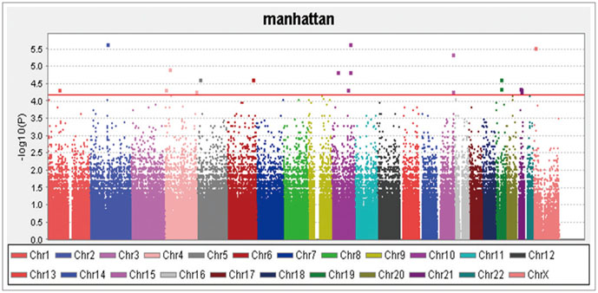
Results: AD Imaging-Genetic Biomarker Interactions
Manhattan plot for all the single nucleotide polymorphisms (SNPs)
Notes:
Imaging Pheno/Genotype Associations: Data

Slide 22
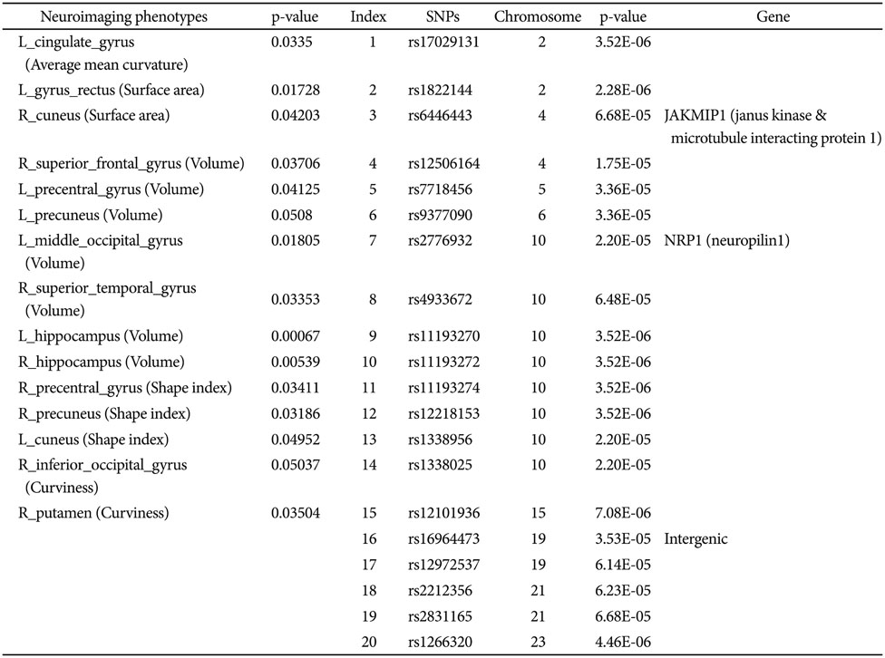
Results: AD Imaging-Genetic Biomarker Interactions
Notes:
Imaging Pheno/Genotype Associations: Data

Slide 23
GWAS Imaging-Genetics Approach
C
|
G
T
|
A
SNPs
E.g., C/T polymorphism
Model
Phenotype: Y_{i} be the imaging-biomarker for i^{th} subject
Genotype: X_{i} be the genotype i^{th} subject at a particular:
SNP $X_{i}=\left\{\begin{aligned}0, BB \\ 1, BA or AB \\ 2, AA\end{aligned}\right.$
SOCR Multivariate Regression Models
$Y_{i}={β_{0}+β}_{1}X_{i}$
$In general,Y_{i}=\sum_{k=0}^{K}{β_{k}X_{i}^{(k)}}+ε$
Stat analysis: $β_{k}$≠ 0
Genotype-Phenotype Relation
Parents
 |  | B | A
 | B | BB | BA
 | A | BA | AA
Notes:
EO = Early Onset
SNP = Single-nucleotide polymorphism

Slide 24
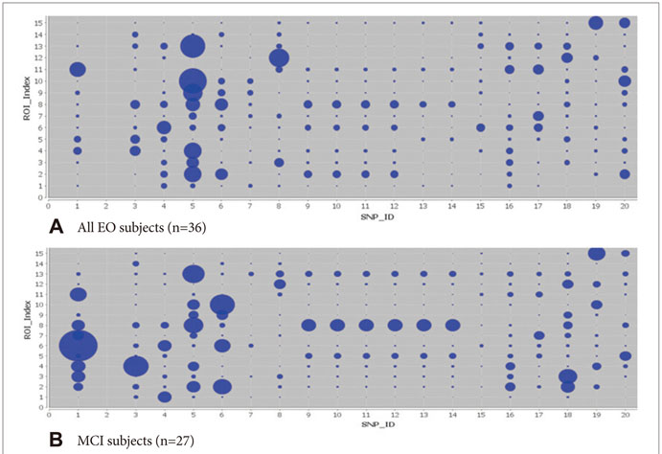
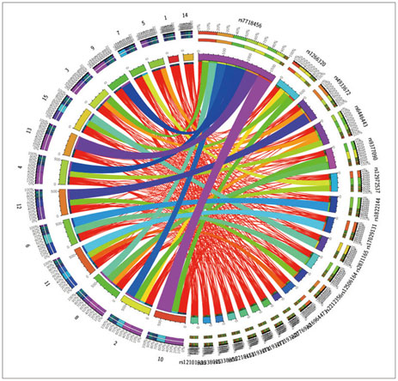
SNP-Neuroimaging interactions in Alzheimer’s Disease
Overall Associations
rs7718456 and L_hippocampus (volume)
rs7718456 and R_hippocampus (volume)
EO-MCI associations
rs6446443 R_superior_frontal_gyrus (volume)
rs17029131 and L_Precuneus (volume)
Notes:
Imaging Pheno/Genotype Associations: Data

Slide 25
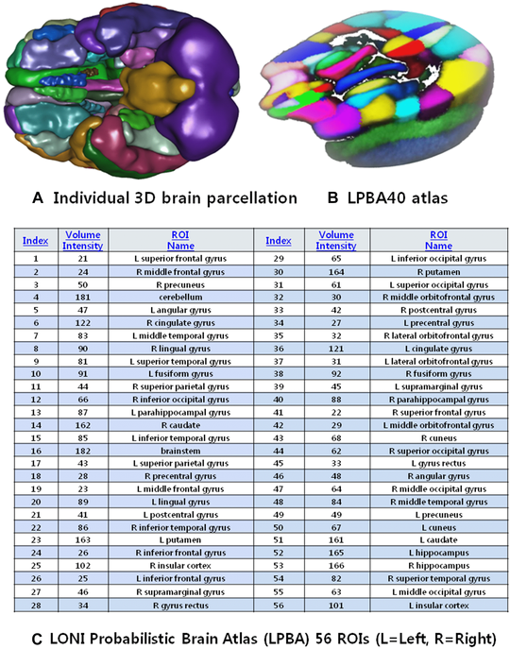
Neurodegenerative Disease Applications:
Imaging-Genetic Biomarker Interactions in Alzheimer’s Disease
Goals
Investigate AD subjects (age 55 – 65) using Neuroimaging Initiative (ADNI) database to understand early-onset (EO) cognitive impairment using neuroimaging and genetics biomarkers
Results
Generated mean geometric models of the left and right hippocampi, middle frontal gyri, and the middle temporal gyri.
Linear model statistical maps, at each vertex on the triangulated shapes. Dependent variable was the radial distance morphometry measure (deviation of individual shape model from mean shape atlas) and independent regressors including diagnosis, age, education years, APOE (ε4), MMSE, visiting times, and logical memory (immediate and delayed recall).
Approach
Local Shape Analysis (LSA) Pipeline workflow
Moon, Dinov et al., 2015, J Neuroimaging
Notes:
Imaging Pheno/Genotype Associations: Data

Slide 26
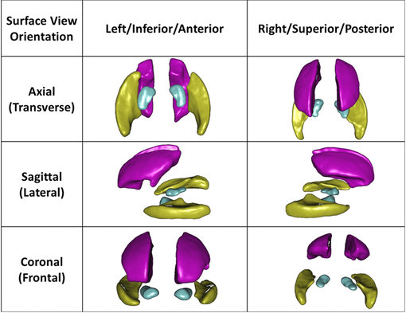
Neurodegenerative Disease Applications:
Imaging-Genetic Biomarker Interactions in Alzheimer’s Disease
Moon, Dinov et al., 2015, Neuroimaging.
Notes:
Mean geometric models of the left and right hippocampi (turquoise), middle frontal gyri (pink), and the middle temporal gyri (yellow). The surface-based statistical maps are computed on each vertex of these atlas shapes

Slide 27
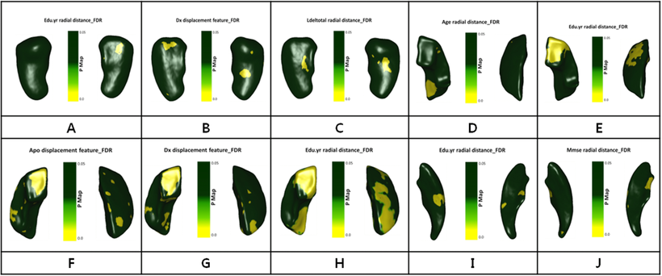
Neurodegenerative Disease Applications:
Imaging-Genetic Biomarker Interactions in Alzheimer’s Disease
P-maps (A) for Lt. hippocampus, P-maps (B,C) for Rt. Hippocampus, P-maps (D,E) for Lt. middle frontal gyrus, P-maps (F,G,H) for Rt. middle frontal gyrus, P-maps (I, J) for Lt. middle temporal gyrus.
Moon, Dinov et al., 2015, J Neuroimaging
Notes:
Statistical maps generated by the LSA workflow. Each insert image illustrates on the three-dimensional shapes the statistically significant P values, which are generated by fitting linear models at each vertex on the triangulated shapes. The dependent variable was the radial distance morphometry measure (deviation of individual shape model from mean shape atlas) and independent regressors including diagnosis, age, education years, APOE (ε4), MMSE, visiting times, and logical memory (immediate and delayed recall). Legend: P-maps (A) for Lt. hippocampus, P-maps (B,C) for Rt. Hippocampus, P-maps (D,E) for Lt. middle frontal gyrus, P-maps (F,G,H) for Rt. middle frontal gyrus, P-maps (I, J) for Lt. middle temporal gyrus.

Slide 28
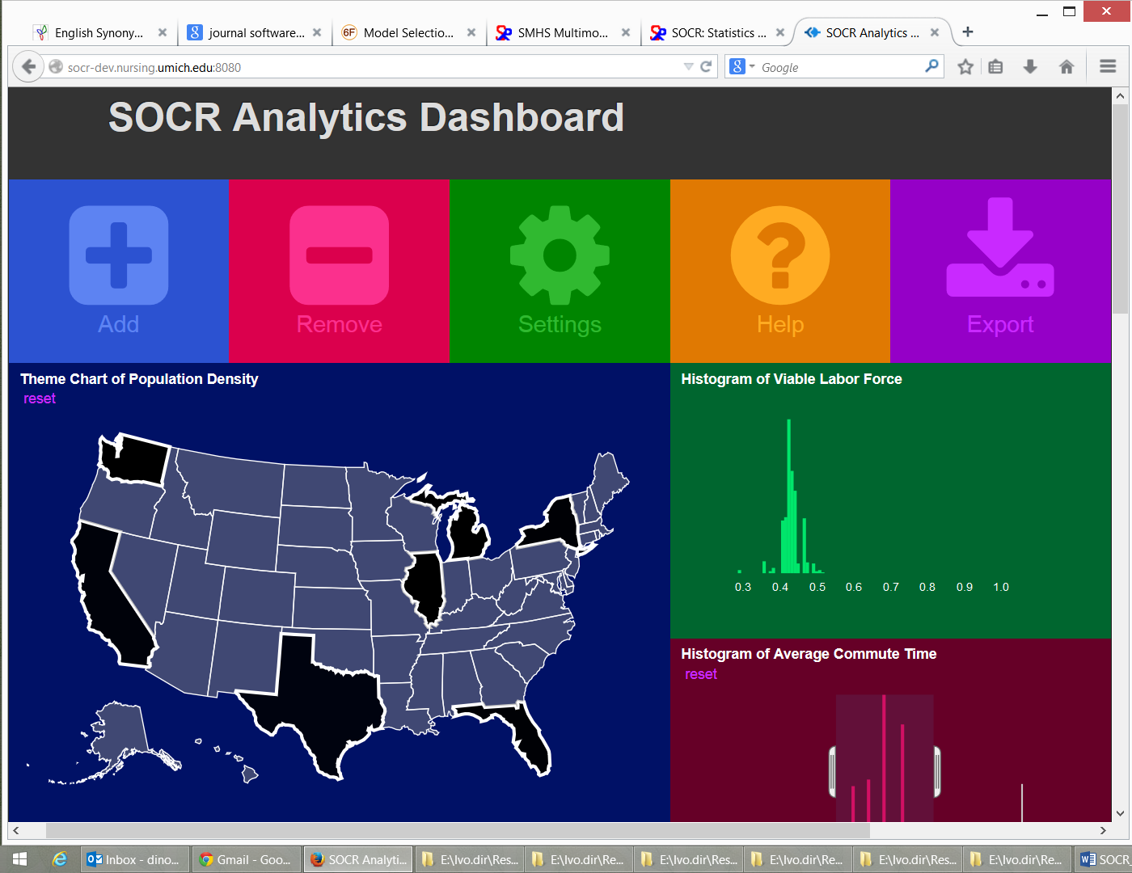
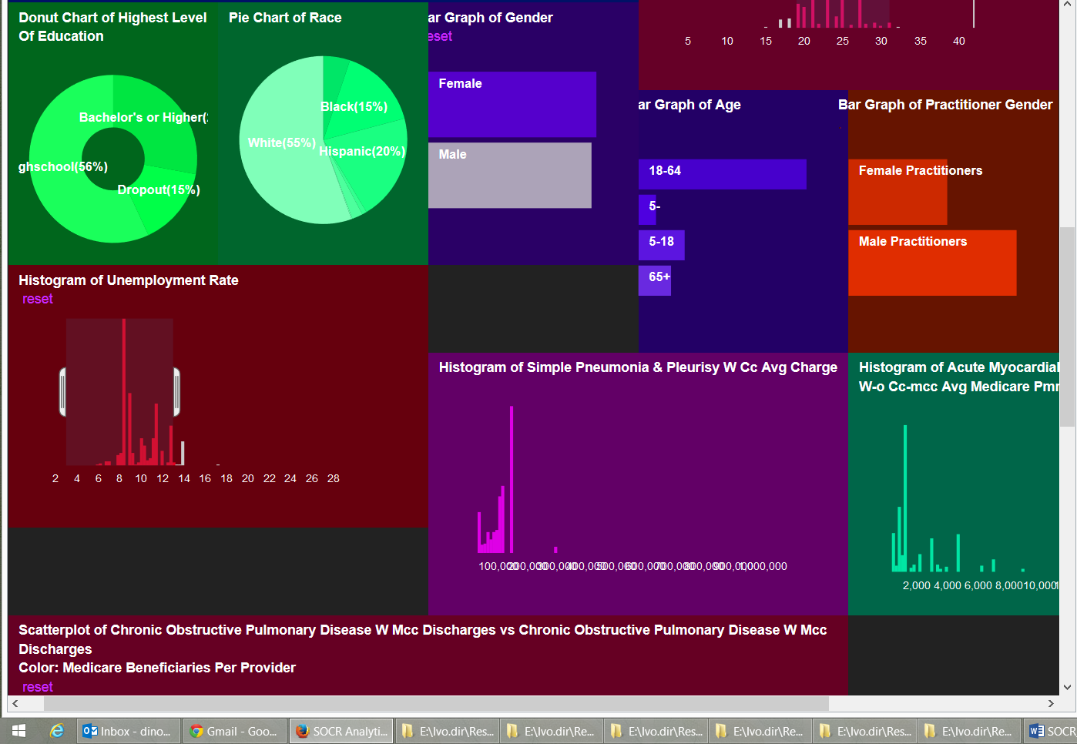
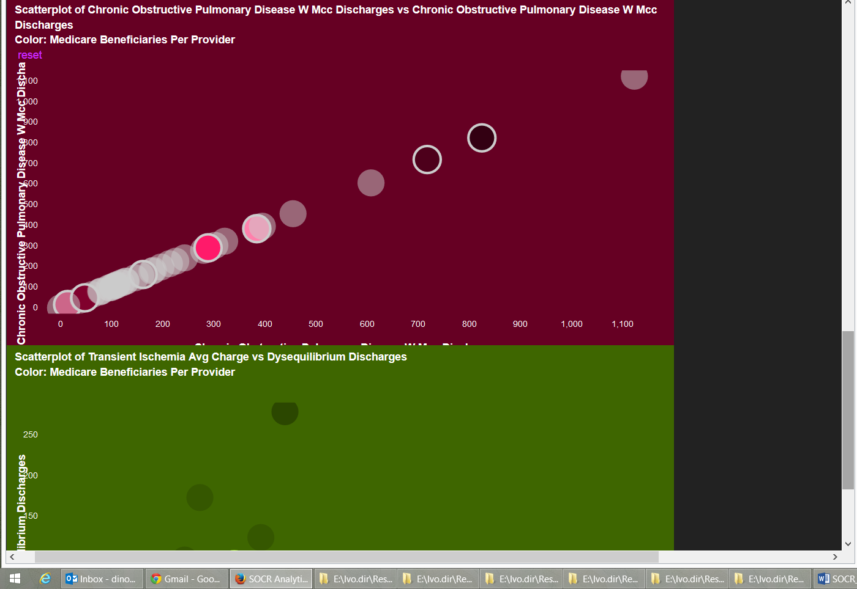
SOCR Big Data Dashboard
http://socr.umich.edu/HTML5/Dashboard
Web-service combining and integrating multi-source socioeconomic and medical datasets
Big data analytic processing
Interface for exploratory navigation, manipulation and visualization
Adding/removing of visual queries and interactive exploration of multivariate associations
Powerful HTML5 technology enabling mobile on-demand computing
Husain, et al., 2015, J Big Data

Slide 29
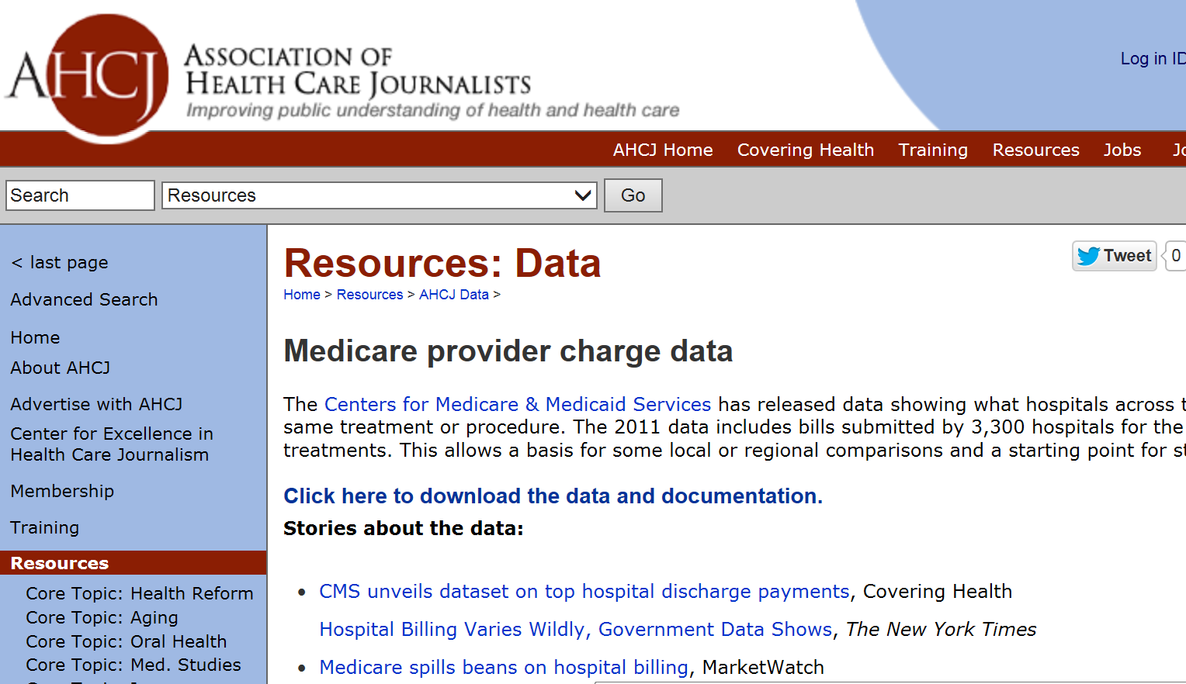
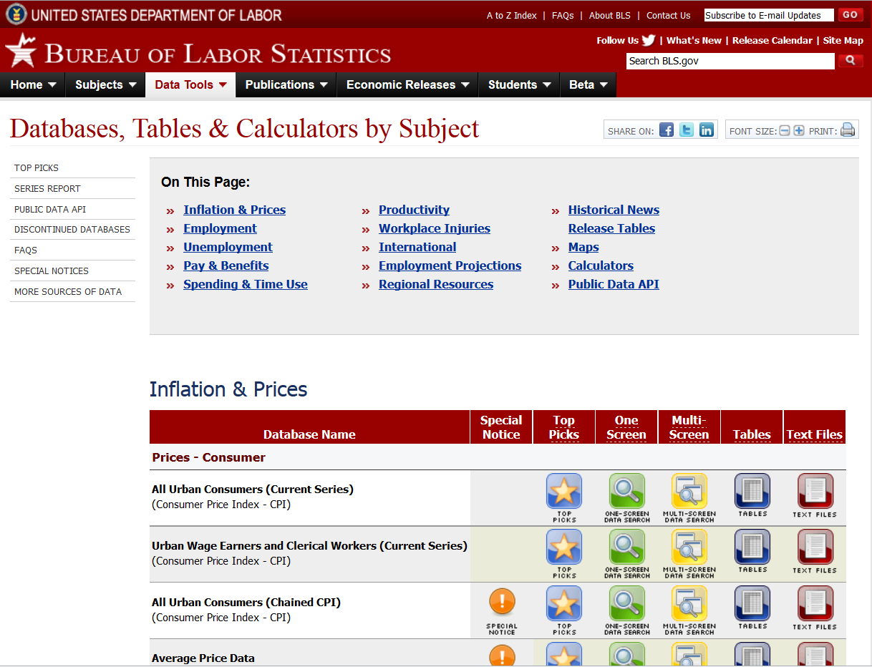
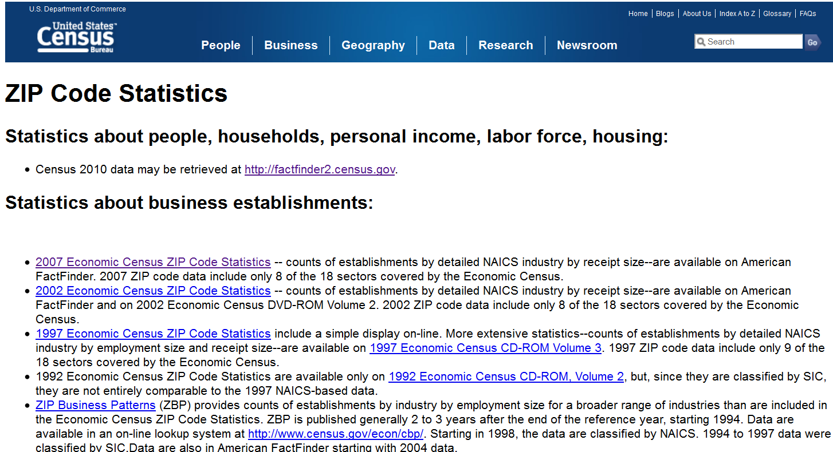
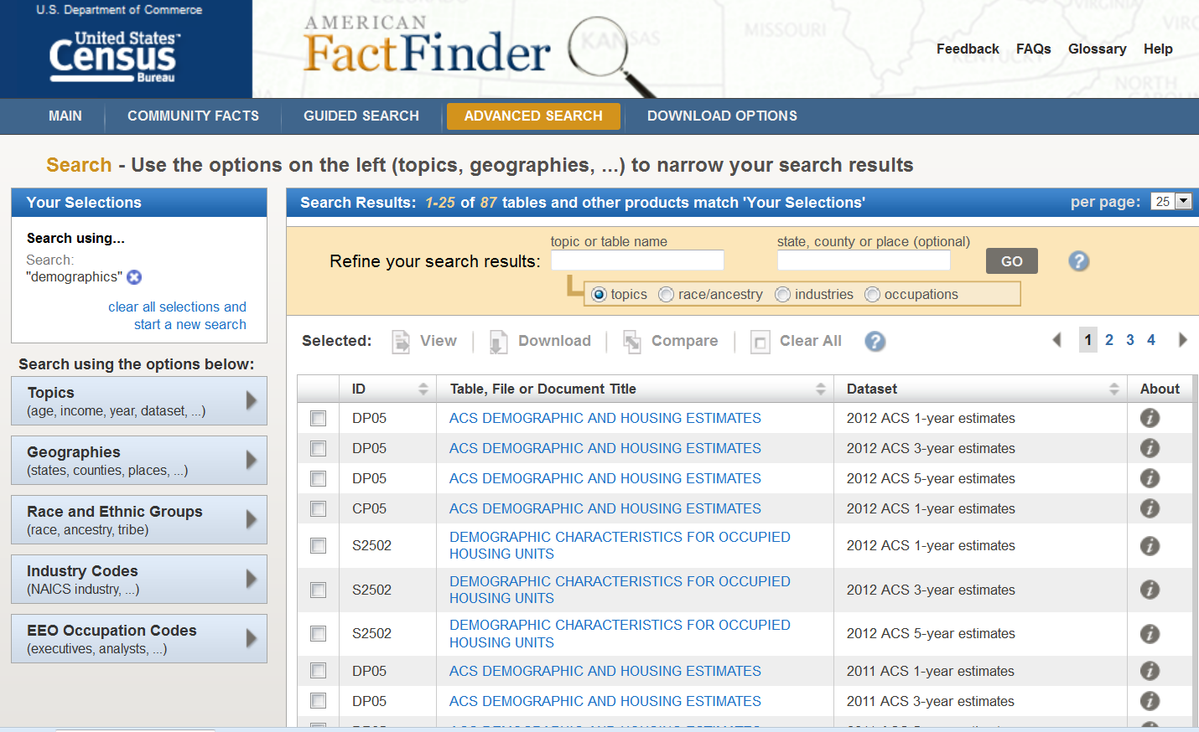
SOCR Dashboard (Exploratory Big Data Analytics): Data Fusion
http://socr.umich.edu/HTML5/Dashboard
Notes:
Imaging Pheno/Genotype Associations: Data

Slide 30
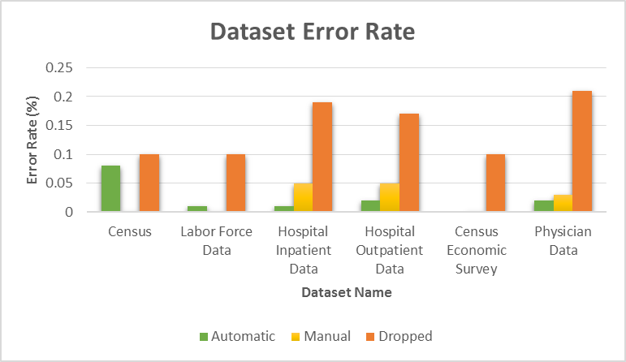
SOCR Dashboard (Exploratory Big Data Analytics): Data QC
http://socr.umich.edu/HTML5/Dashboard
Notes:
Imaging Pheno/Genotype Associations: Data

Slide 31
Training: Big Data Skills
Listening: streams, information and language, analyzing sentiment, intent and trends;
Looking: searching, indexing and memory management of heterogeneous datasets; Loading: Raw, derived or indexed data as well as meta-data;
Programming: Handling Map-Reduce/HDFS, No-SQL DB, protocol provenance, pipeline workflows;
Inferring: Principals of data analyses, Bayesian modeling, inference, uncertainty and quantification of likelihoods; Connecting: Reasoning, logic and its limits, dealing with uncertainty; Analytics: Regression, feature selection, dimensionality reduction, temporal patterns;
Learning: Classification, clustering, mining, information extraction, knowledge retrieval, decision making;
Predicting: Forecasting, neural models, deep learning, and research topics;
Summarizing: Presentation of data, processing protocol, analytics provenance, visualization

Slide 32
Training: Core Proficiencies
The Data Science Certificate program aims to ensure that students awarded this certificate would have the following experiences:
(Modeling) Understanding of core Data Science principles, assumptions and applications
(Technology) Knowledge of basic protocols for data management, processing, computation, information extraction & visualization
(Practice) Hands-on experience with modeling tools and technology resources in a real project setting

Slide 33
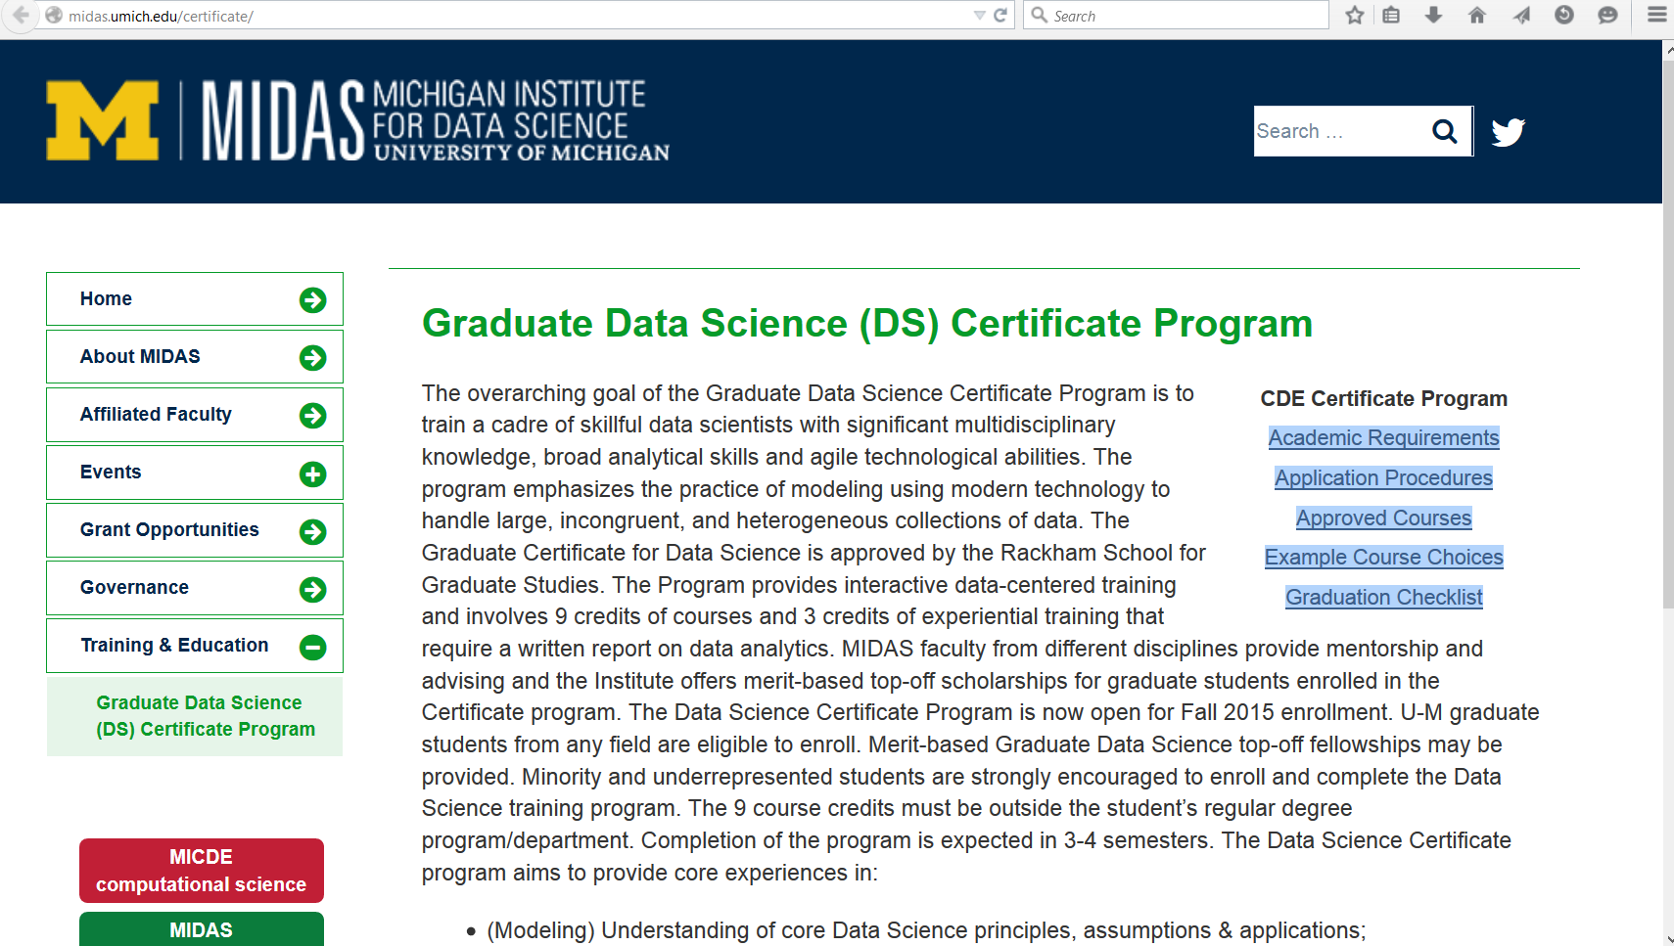
University of Michigan Data Science Training
http://midas.umich.edu/training
Notes:
http://bd2k.org/BigDataResourceome.html

Slide 34
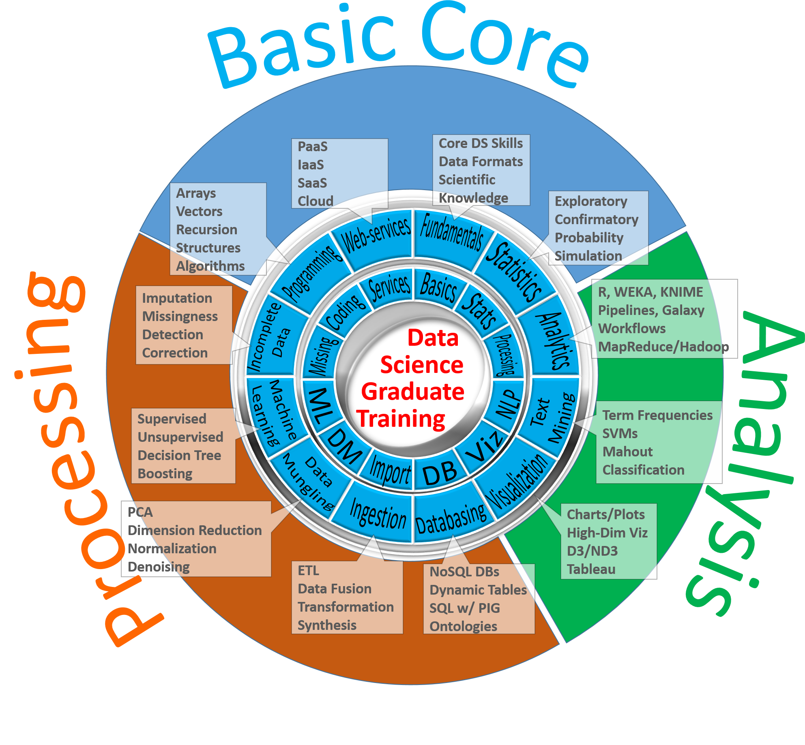
Big Data
Science
Notes:
10¹⁵ Peta-Byte data demands, Michigan Institute for Data Science (MIDAS): Rackham Graduate Data Science Training Certificate.

Slide 35
Paradigm Shift in Higher Ed & Training
A natural parallel to the 4-pillar scientific discovery paradigm (experimental, theoretical, computational, and data sciences) can be developed for higher ed learning
The new paradigm shift in science and technology education and training involves 4 complementary abilities and skills necessary to handle, understand and interpret complex phenomena using Big Data observations:
Literacy, which provides the deep domain-specific knowledge (e.g., math, phy, bio, eng, stats, enviro, social, etc.),
Numeracy, which develops the skills to process hard information, manipulate numbers, and understand analytical models,
Algorithmacy, which provides the foundation for developing, optimizing and evaluating protocols, pseudo code, and (jointly with numeracy) facilitates programming, and
Datacy, which is the new skillset required to understand natural processes, via Big Data proxies, manipulate, extract and synthesize information, develop and evaluate predictive and decision support models.

Slide 36
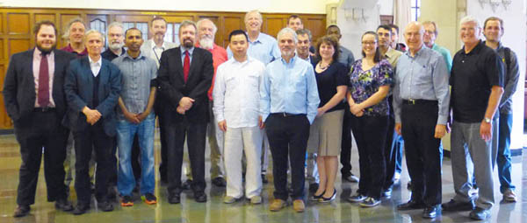
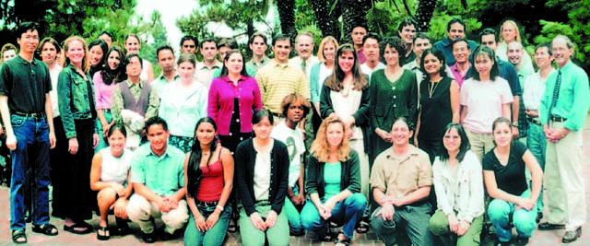
Acknowledgments
Funding
NIH: P20 NR015331, U54 EB020406, P50 NS091856, P30 DK089503
NSF: DUE 1416953, 0716055, 1023115
Collaborators
SOCR: Alexandr Kalinin, Selvam Palanimalai, Syed Husain, Ashwini Khare, Rami Elkest, Abhishek Chowdhury, Patrick Tan, Gary Chan, Andy Foglia, Pratyush Pati, Brian Zhang, Juana Sanchez, Dennis Pearl, Kyle Siegrist, Nicolas Christou, Rob Gould
AtheyLab: Alex Ade, Ari Allyn-Feuer, Gen Zheng, John Wiley, David Dilworth, Walter Meixner, Jeffrey R. de Wet, Kevin Smith, Amy Creekmore, Indika Rajapakse, Gerry Higgins, Robert W. Veltri, Brian Athey
LONI/INI: Arthur Toga, Roger Woods, Jack Van Horn, Zhuowen Tu, Yonggang Shi, David Shattuck, Elizabeth Sowell, Katherine Narr, Anand Joshi, Shantanu Joshi, Paul Thompson, Luminita Vese, Stan Osher, Stefano Soatto, Seok Moon, Junning Li, Young Sung, Fabio Macciardi, Federica Torri, Carl Kesselman

